Slide 1













Facilitating belonging for newcomer migrant students at MHS
(2025). Felicia Akerele, Kaitlyn Dodgen, Yaa Donkor, Nando Felten,
Dave Kobel, Cameron Lloyd, John Mobley IV, Karen Nortz, Chelsie Riche, Dreama Rhodes, Nora Rodman, Ricky Urgo, Viviana Velez Negron, Jason Westra-Hall, Ben Wilkerson, Dr. Michelle Bellino
EDUCATION 792

Slide 2




INTRODUCTION
Welcome! Thank you for making the journey from Melvindale to Ann Arbor.
Over the past three months, you were kind enough to open your doors to us, and we are thankful. Over our time at Melvindale, we completed 70 hours of classroom observation and conducted 25 interviews with teachers and students. We are excited to share what we have found with you!

Slide 3

Agenda
BACKGROUND INFORMATION
FINDINGS
RECOMMENDATIONS
1
2
3
03
UM-MHS collaboration
Research questions
Theory & frameworks
Newcomer student experience
Opportunities for support and connection
Challenges faced by newcomers
ELL courses
Orientation and onboarding
Expectations
Multilingual resource guide
Notes:
This slide deck is an overview of our collaborative project. It starts with background information, including a history of our collaboration with MHS and an account of how we came to establish our central research questions, and the theoretical frameworks we drew on throughout the project.
Then we present our three main findings related to student experiences, opportunities for connection and support, and challenges faced by newcomer students.
Finally, we move into our recommendations, informed by the principal research findings. Recommendations center on ELL courses, orientation and onboarding processes, students’ expectations, and the possibility of creating a multilingual resource guide for newcomer migrant students.

Slide 4
Background Information
1

Slide 5


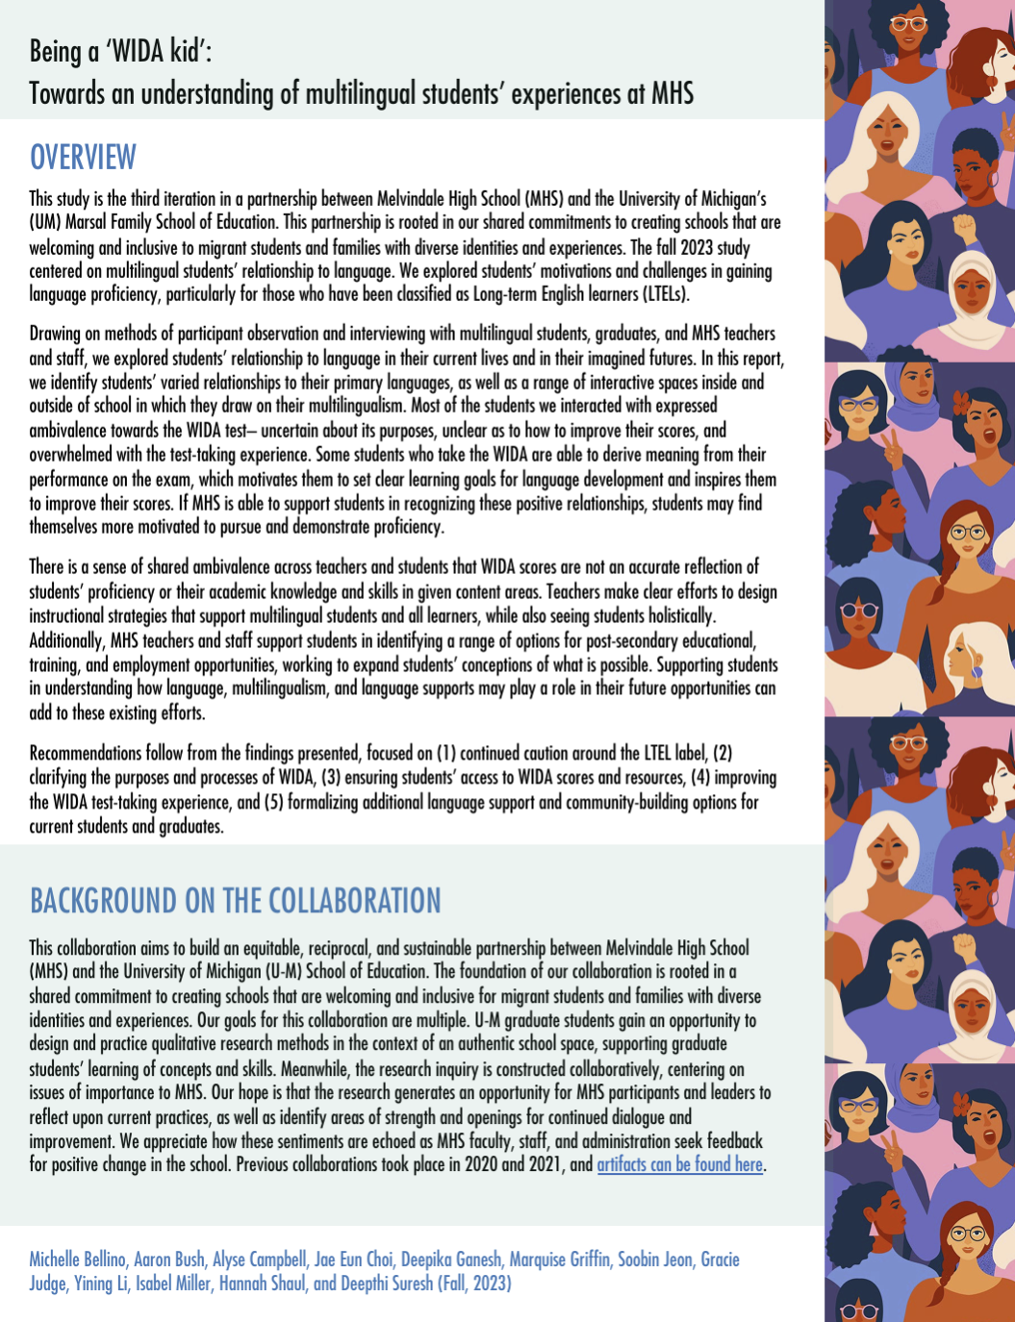

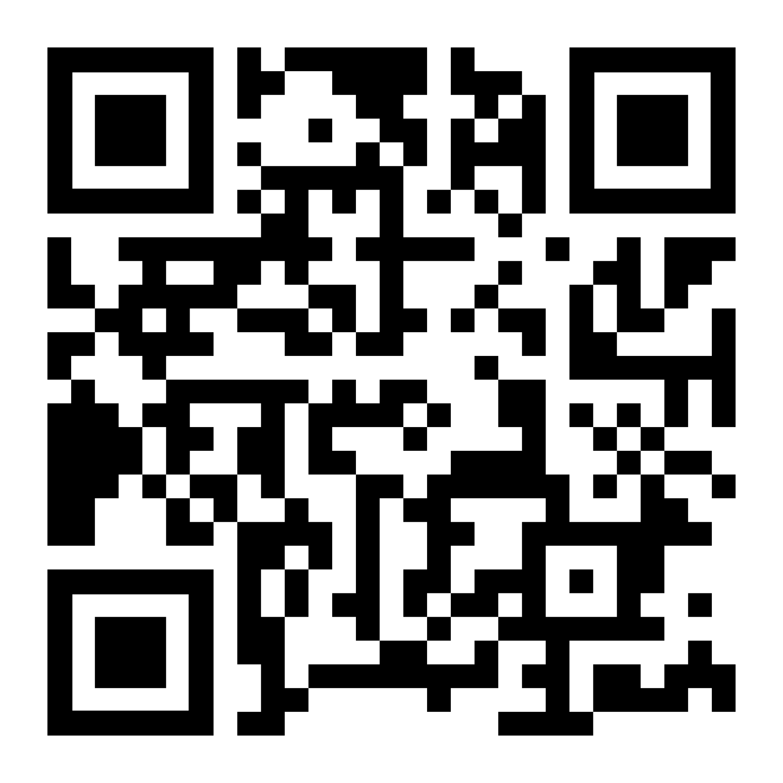
MHS-UMich History
2020
2021
2023
2024
Building a responsive school system
From Welcoming to Belonging
Being a ‘WIDA Kid’
Being in Community
Newcomer Experiences
Newcomer Belonging
Multilingual Experiences
Family-School Engagement
Notes:
Beginning from conversations back in 2018, this partnership between Melvindale High School and the University of Michigan has developed over the years. With the first iteration of this collaborative research taking place in 2020, subsequent years have continued to shift in focus and direction as the needs/experiences/perspectives of students have been identified by MHS leaders. Reports have included:
2020 - Supporting Recently Arrived Students: Lessons Learned from MHS — This first report looked at a number of elements at MHS that work towards a responsive school system, to support a population of students “on the move.”
2021 - From Welcoming to Belonging at Melvindale High School — This report initially began with a focus on the newcomer onboarding process, which led us to examine ways that initial welcome can shape issues of belonging over the longer term.
2023 - Being a ‘WIDA kid’: Towards an Understanding of Multilingual Students’ Experiences at MHS — The focus for this one was Long-term English Language Learners (LTELs). It explored multilingual students’ relationship to language and language learning. Not surprisingly, the WIDA test became a central point of focus.
2024 - Being in Community: Understanding Family-School Engagement at MHS — Last year’s report moved outside the school walls to consider issues of family engagement and how MHS builds community.
For more information and to read previous reports, please visit the research page on Dr. Michelle Bellino’s website by using this link <https://mjbellino.com/research/> or by scanning the QR code above.
For 2025, the following slide outlines the major research questions underpinning our investigation this year.

Slide 6
Research Questions
1: How do newcomer migrant students at MHS experience a new school environment?
2: What challenges do they face? What opportunities exist for support and connection?
3: What ideas do they have about how to improve their school experience?
Notes:
These questions were co-created with MHS administrators and have guided our inquiry. During our initial meeting with MHS administrators this fall several potential topics arose, including: experiences of older newcomer students and experiences of longer-term ESL students who have been in the US for a period of time but still require high language support. These interests, coupled with a general interest in student wellbeing, led us to these three research questions with a broader view on how newcomer students experience the transition to a new school environment, the challenges they face, and opportunities for support and connection. We also wanted to know what newcomer students and key staff who work with this student population believe could or should be changed to improve the newcomer student experience.

Slide 7

Literature Review
We conducted a literature review to build our collective understanding and frame our thinking on the newcomer experience.
Notes:
As we moved from developing our research questions with the MHS administration to beginning to visit the school and collect data, we conducted a literature review in order to build our collective understanding and frame our thinking on the newcomer experience. This literature review included academic research, policy papers, and practitioner-focused materials.
Reviewing the wider research on newcomers served a few purposes:
First, our research team had a wide variety of experiences (some more and some less, or none at all) in K-12 schools with newcomer and multilingual student populations, so this helped level set across the group.
Second, it allowed us to see what researchers have learned about the newcomer experience across a variety of school and district contexts around the country, giving us a broader lens.
And third, it helped us make sense of some of the data we began to collect.
The following slides are just a small sample of the research we reviewed together.

Slide 8
Guiding Perspective
Social Ecological Model (adapted from Bronfenbrenner, 1979)
Changes in Environment Over Time:
Educational disruption, migration, cultural and demographic changes over time.
Chronosystem
Broader Culture:
Differences in norms and views about schooling between U.S. and country of origin. Embrasure, not erasure, of newcomers’ cultures.
Macrosystem
Exosystem
Indirect Influence on Students & Schools:
Government (District, Local, State, Federal) Policies Affecting Migration, Newcomers, and Belonging. School policy that helps or hinders belonging.
Mesosystem
Microsystem
Relationships between Individuals:
Peer-to-Peer & Student-Teacher Relationships, Unfamiliar educational context (e.g., U.S.).
Individual People:
Individual perceptions of belonging, Individual language acquisition.
Notes:
Bronfenbrenner’s (1979) ecological systems theory can be situated both locally and globally. At the center- the microsystem level- we have individuals who are all affected by their relationships, environment, and culture.
Shifts in the larger circles have effects on all the systems nested within them, but can also shift relationships between individuals in systems.
For example, as governmental policies influencing schools rapidly change, the relationships between districts, between schools, and even between individuals may change. This is especially felt when considering policy shifts such as mass deportations, funding cuts, and rising xenophobia. In short, what happens in each of these systems impacts the experience of the individual at the center.
This model is also a powerful way to think about the ways that schools can impact these inner and outer contexts. When schools are designed with belonging in mind, it affects the individual, and also impacts the relationships between individuals, including their capacity to extend that hand of support. So the institutional culture and everyday practices in schools matter in shaping experiences and opportunities for individuals, both newcomers and their classmates.
Meanwhile, socioecological systems are also a reminder that individuals have the power to shape their contexts. When our team spoke with Mr. Kassell, he pointed out that kindness isn’t an issue at MHS. Most everyone is polite. But what he called “outgoing kindness” is what he projected would have the greatest impact on belonging.

Slide 9
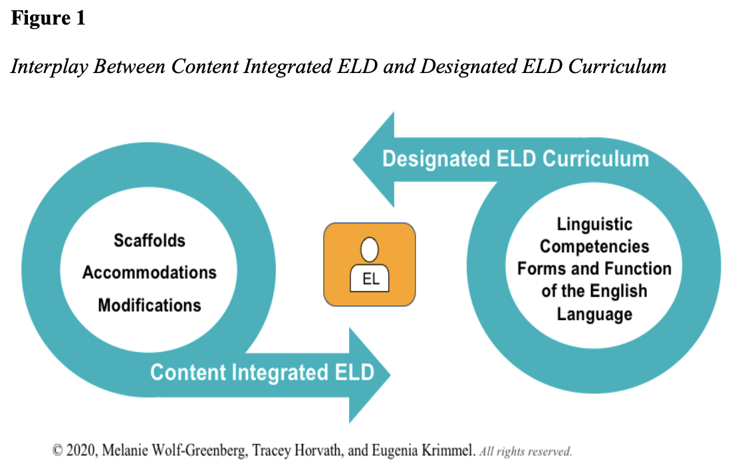
Literature on ELD Approaches
Wolf-Greenberg, M., Horvath, T., & Krimmel, E. F. (2022). Three Steps to Create a Designated ELD Curriculum Aligned to Academic Content. Journal of English Learner Education.
Notes:
Language—both affirmation of the home language, and acquisition of the English language—is a critical facet of the newcomer experience.
Wolf-Greenberg, Horvath, and Krimmel discuss the ways that schools serve the language needs of newcomer students as they construct ELD programming. They differentiate between “integrated ELD,” which includes language supports in the content-area classroom, and “designated ELD,” which includes courses specifically intended to develop English language skills. We saw both types of language support at MHS in content area classrooms and the classes in the ELD and Bridge Programs.

Slide 10
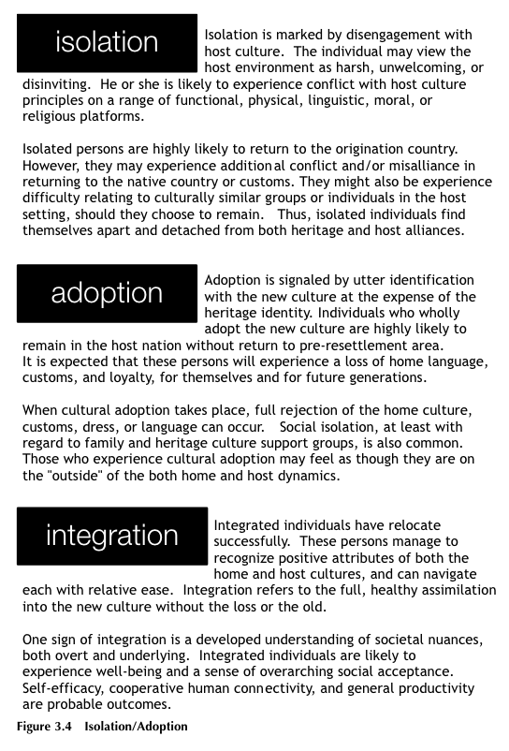
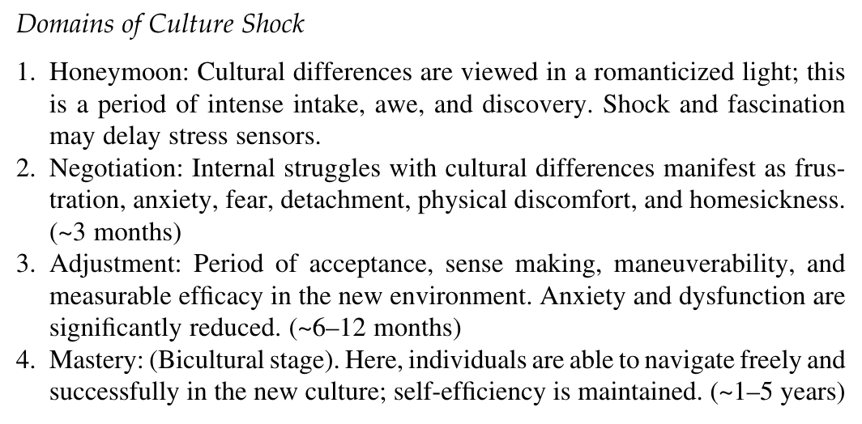
Literature on Social Adjustment for Newcomer Migrant Students
Adjustment Domains
The Process
Kreuzer, L. H. (2016). The Newcomer Student: An Educator’s Guide to Aid Transitions. Bloomsbury Academic.
Notes:
Importantly, the newcomer experience goes beyond language. Kreuzer, in her work studying how schools can best aid the transition to the new school context, defines the concept of culture shock as “the forced disengagement from known elements…language, geographic and cultural guideposts, family and community supports.”
She describes how culture shock follows a predictable process: from a honeymoon stage, to negotiation, adjustment, and mastery.
The adjustment stage within the first year of arrival is often of great import for aligning on healthy goals for school resources: we want to avoid outright rejection of the new cultural context (isolation), and we also want to avoid rejecting the home culture (assimilation). Instead, a healthy goal is “integration,” a holistic marriage between heritage and host cultures, in which “pre-transition identities are preserved, even as new social adaptations are underway.”

Slide 11

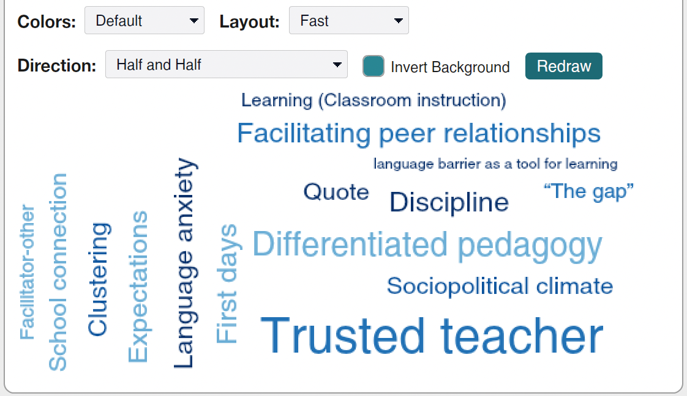
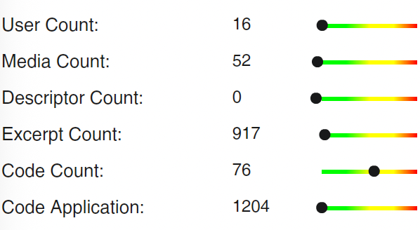
Methods
Data Collection
Data Analysis
44 Observations
Used on online program, Dedoose, to code
Used codes based on themes that arose
Over 70 hours from classroom observations, meetings, and school-wide students events.
19 Student Interviews
6 Teacher Interviews
Notes:
Our sample included: 18 total students and 6 teachers interviewed, along with 44 observations. Observation classrooms and interviewees were selected because of high EL student counts, to maximize our understanding of the newcomer experience and the experiences of teachers and staff who support them.
We created two separate interview guides, one for teachers and one for students.
For students, we were interested in learning about:
Prior experiences and expectations
First experiences as a newcomer at MHS
Reflecting on school experience at MHS
Supports, connections, and representation at the school
For teachers, we were interested in learning about:
Experiences, practices, and relationships with newcomer students
Perceptions on newcomer support and connection
Support and connection for teachers
Observations were recorded through fieldnotes
For data analysis, we developed codes based on themes that arose across the observations and interviews. To approach this systematically, we used an online program called Dedoose, which allowed us to assign codes and look at them thematically, as well as explore how codes were interacting.

Slide 12
Findings
2

Slide 13
Finding 1: How newcomer students
experience a new school environment
Many newcomer students expressed confusion, fear, and resolve around their first day at MHS, and teachers perceive and empathize with these feelings. Peer support is helpful.

Slide 14
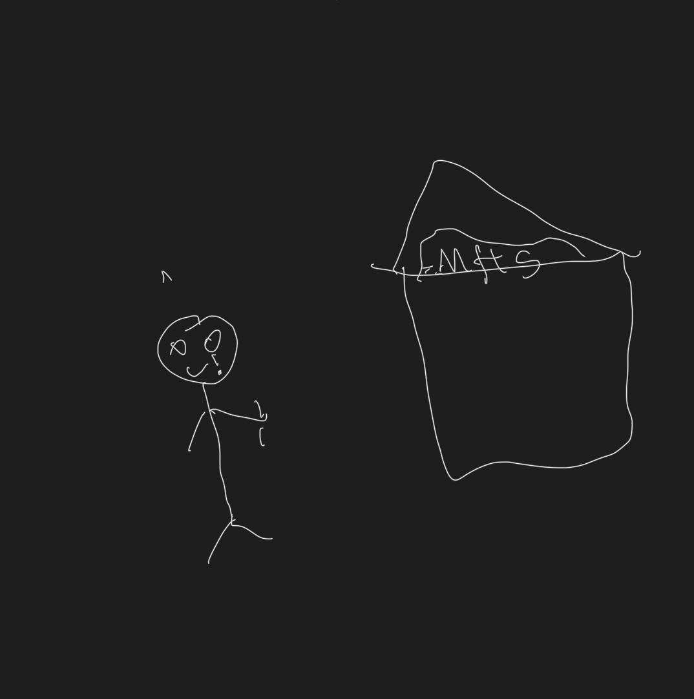
الانتماء
belonging
مجتمع
bienvenido
pertenencia
First Day of School at MHS
comunidad
مرحباً
community
welcome
Notes:
During our interviews with newcomer students, we engaged in an expressive, arts-based activity. We asked students to draw a picture, find a meme or GIF, or identify a song that represented their first day of school. We hoped that visually describing their initial experiences would give them more freedom of expression and enable us to have a richer conversation.
In this first picture, a student drew a building with “MHS” on top, and depicted himself as separate, physically outside the school. There is tear coming from his eye. He described himself as “scared” on the first day of school because he didn’t have friends and spent the day by himself.

Slide 15
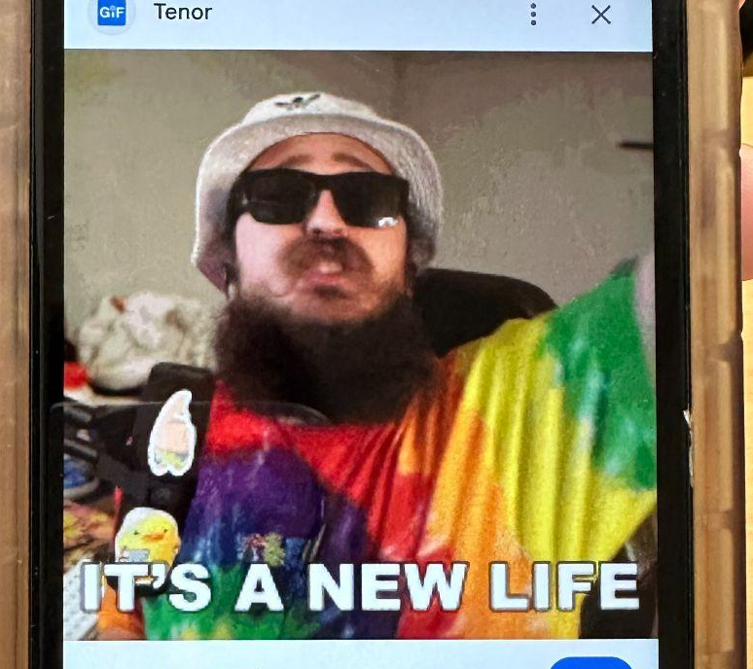
الانتماء
belonging
مجتمع
bienvenido
pertenencia
First Day of School at MHS
comunidad
مرحباً
community
welcome
Notes:
Another student selected this image. We might consider this image closer to the “honeymoon” stage of Kreuzer’s (2016) adjustment model, ready to embrace all that comes at them. When we asked the student why she chose this image, she said “quería tomar todo positivo, de que va a ser divertido, entretenido y dejar los nervios afuera.” She wanted to bring a positive mindset to her first day, telling herself that it was going to be fun. She was determined to “let go of her nerves.”
English Translation:
"I wanted to take everything in a positive light, to believe it was going to be fun and entertaining, and leave the nerves behind."

Slide 16
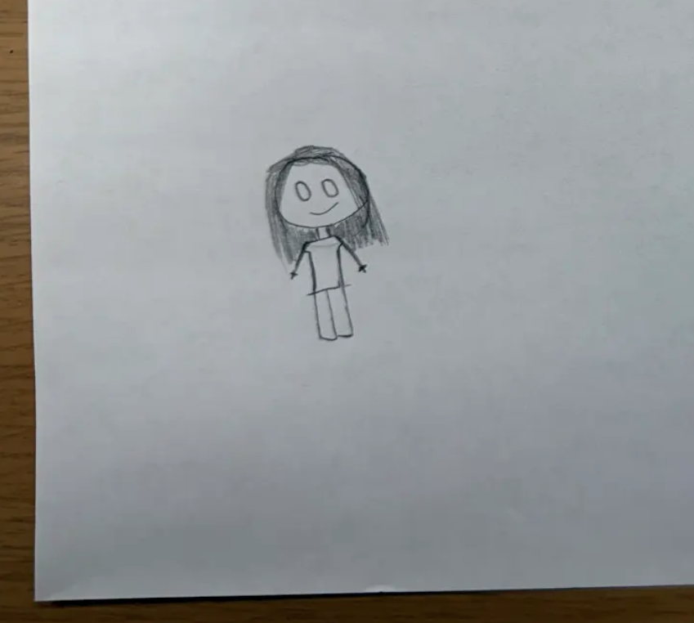
الانتماء
belonging
مجتمع
bienvenido
pertenencia
First Day of School at MHS
comunidad
مرحباً
community
welcome
Notes:
In this third picture, a student described herself as “Estaba emocionada de venir y pues casi todo el día estuve feliz. Estuvo interesante. Ese primer día tuve miedo porque pues no sabía y no sabía dónde iba a ir y pues ahí mi amigo me ayudó, me llevó a la clase de Ms.Alata y pues ahí me ayudó con mis clases y así y pues estaba bien. Sí me gustó el primer día. Pues porque me sentía emocionada de saber cómo iba a ser aquí la vida.”
English translation: “I was excited to come, and I was happy almost all day. It was interesting.” That first day I was scared because I didn't know anything, and I didn't know where I was going, but my friend helped me. He took me to Ms. Alata's class, and she helped me with my classes and everything, and it was fine. I did like the first day. I was excited to see what life would be like here.”
We want to highlight that there has been a shift for some students from that first day. Many have moved closer to that “adjustment” experience in Kreuzer’s (2016) model. But some, like this student, haven’t. This student shared that they don’t feel the same excitement anymore because they thought it was going to be different, but they haven’t made friends. This raises questions about what different newcomer students might be experiencing– and what the school could do to support that adjustment process for all students.

Slide 17
Finding 1: How newcomer migrant students at MHS experience a new school environment
Teachers perceive the first-day feelings of their students. They empathize & sympathize with them .
“The first day for a newcomer is usually emotional for them. You can feel the frustration, you can feel the thoughts that they have–the ongoing thoughts on their first day at a new school, new people, new life, new language.” - Teacher

Slide 18
Finding 2: Opportunities to
Support Newcomer Belonging
There are relational, organizational, and linguistic school-based practices that support newcomer belonging.
Notes:
In response to the opportunities piece of our second research question, we found that there are relational, organizational, and linguistic school-based practices that support newcomer belonging.

Slide 19
Finding 2: Opportunities to Support Newcomer Belonging
Strong adult and peer relationships
Language skills and aspirations are leveraged and affirmed
Relational
Linguistic
Organizational
School routines and resources facilitate student learning
Notes:
Our second research question asked: What opportunities exist for support and connection for newcomer students?
Across the data we gathered, we identified practices that facilitate belonging for newcomer students in three dimensions: linguistic, relational, and organizational.
Linguistic practices: Students experience a greater sense of belonging when…
their linguistic background is affirmed and celebrated, and when their home languages and existing funds of knowledge are leveraged to facilitate learning (i.e., translanguaging); and
there are robust opportunities—both within classrooms and via extracurricular activities—for students to develop their English language skills in a way that affirms their language aspirations (e.g., the ELD and Bridge Programs; language clubs).
Relational practices: Students experience a greater sense of belonging when…
there are opportunities for caring, supportive relationships with trusted teachers and staff mentors; and
there are opportunities for students to develop strong peer networks, and to both support and be supported by other students (e.g., informal peer support; the peer mentoring program).
Organizational practices: Students experience a greater sense of belonging when…
they have a strong handle on the “hidden curriculum” of school rules, routines and procedures (e.g., expectations, bell schedules).
technology within the classroom facilitates and accelerates student learning (e.g., translation devices).
Across our observational and interview data collected this fall at MHS, we found examples for supportive practices across all three dimensions. Altogether, these practices help newcomer students feel a greater sense of belonging in the school community.

Slide 20
Finding 2: Opportunities to Support Newcomer Belonging
Language affirmation
Relational
Linguistic
Students benefit when home languages are celebrated and leveraged to facilitate learning.
Organizational
Science class observation:
“…[the teacher] asks the students to the right of the class how to say ‘mitosis’ in Spanish. They answer her by saying something that aligns closely with ‘mitosis’ in the English language. She then turns to her Middle Eastern students and asks how they say it in Arabic. They go back and forth in Arabic with how to say it.”
Translanguaging is more than a strategy to use in the classroom — it’s a mindset that values and leverages the linguistic assets of all students. — WIDA “A guide to translanguaging in the classroom”
Notes:
Students experience a greater sense of belonging when their linguistic background is affirmed and celebrated, and when their home languages and existing funds of knowledge are leveraged to facilitate learning (i.e., translanguaging)
Reference: WIDA, A guide to translanguaging in the classroom

Slide 21
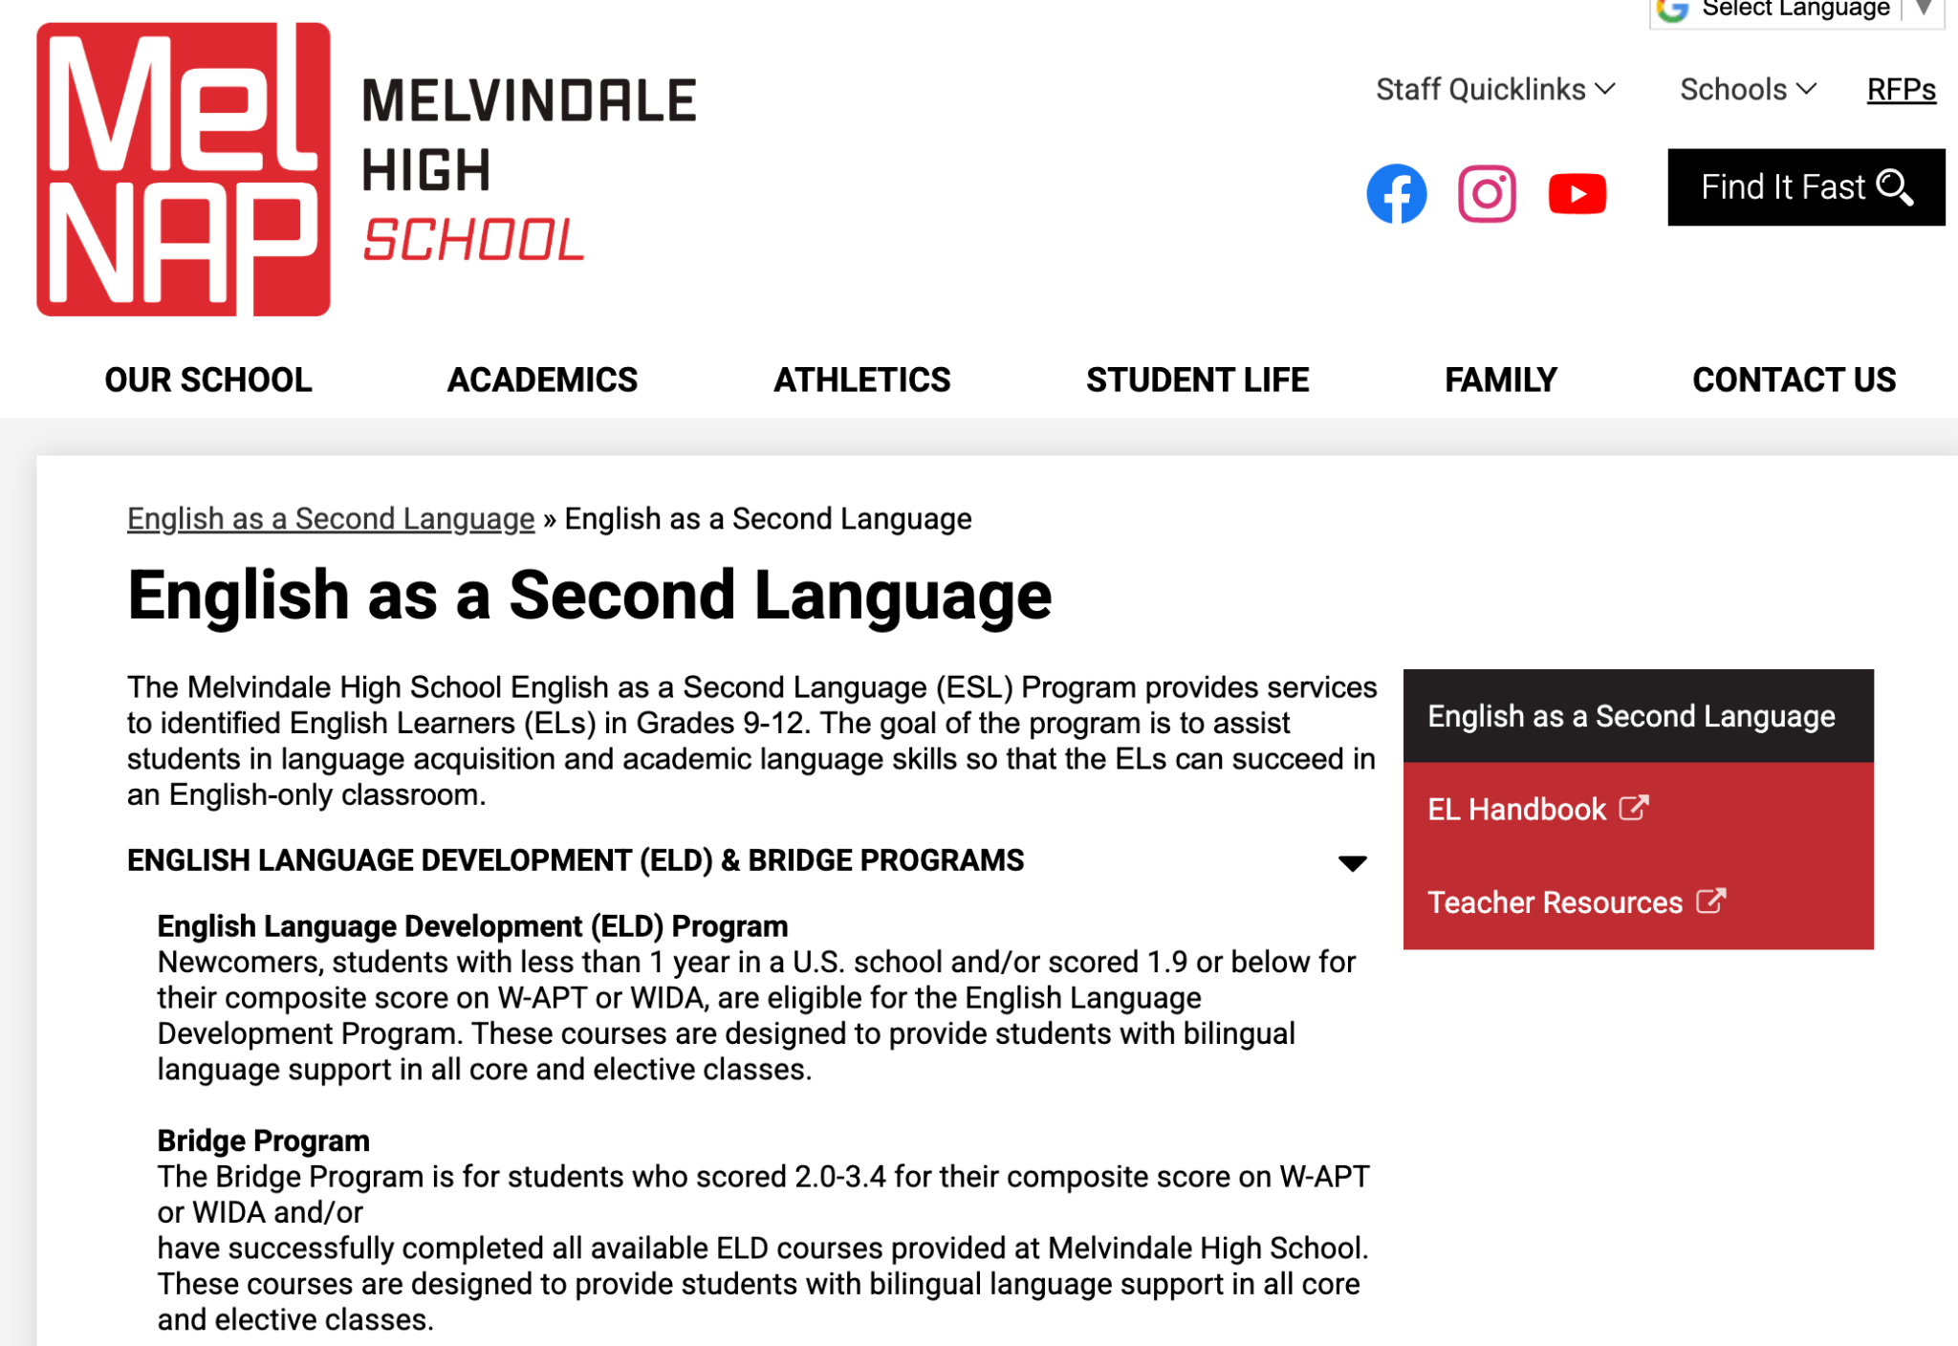
Finding 2: Opportunities to Support Newcomer Belonging
Language aspiration
Relational
Linguistic
Students benefit when the school’s curricular and extracurricular program meets their aspirations to learn and improve English language skills.
Organizational
Newcomer Interview: “So, my favorite class, Miss Alata’s class….because she gave us confidence. She give us a lot of information about the English. I love her.”
Notes:
Students experience a greater sense of belonging when there are robust opportunities—both within classrooms and via extracurricular activities—for students to develop their English language skills in a way that affirms their language aspirations (e.g., the ELD and Bridge Programs; language clubs)
Can look like:
ELD coursework in the ELD and bridge programs
support and accommodations in content-area classes

Slide 22
Finding 2: Opportunities to Support Newcomer Belonging
Students rely on trusted teachers and school staff for support
They describe teachers who inspire their futures, build personal connections across languages, and provide safe spaces in their classrooms, alongside staff who offer support in their home language.
Relational
Linguistic
Organizational
Newcomer Interview: “Student 1: I wanted to be a doctor, but I will change it because I want to be a teacher like my teacher… Student 2: I wanna be like her . Student 1: … confident. Yeah. I want to learn the students who come from anywhere… Student 2: Teach them. Yeah”
Newcomer Interview: “Um, tengo un apoyo sobre un psicólogo escolar de aquí. (I have a referral to a school psychologist here.)”
Notes:
The next dimension is relational belonging. Students depend on trusted teachers and school staff for support. Across our observations and interviews, students repeatedly described teachers not only as instructors for their classes but as trusted adults who know them and care about their wellbeing, both inside and beyond the school walls. This included having conversations about future education and career aspirations and having students reflect critically on what’s happening in their lives. Many teachers worked to learn about student’s lives through informal conversations asking students about their weekends or families. They also did this inside the classroom by using humor and relating course material to their lives. These are all ways that teachers are also drawing on students’ “funds of knowledge” in that they are building connections between school and home life.
Teachers also facilitated peer relationships in the classroom, sometimes through informal mentor pairings in their classrooms or having unstructured time in their classes to facilitate peer-to-peer dialogue.
Students also described depending on support staff, especially if the support is offered in their home language. Arabic-speaking students had several teachers in mind that they could talk to for additional support as needs arose. Spanish-speaking students frequently said that Ms. Mora is the first adult they would go to if they had a problem, which truly shows the importance of having staff who speak the students home languages. Other students also mentioned having referrals to the school psychologist and using them for support.

Slide 23
Finding 2: Opportunities to Support Newcomer Belonging
Relational
Linguistic
Students rely on peers and other students for support
Organizational
Connect | Being Social and Outgoing
Faculty Interview: “One of the interesting things I see lately here is that there are kids who want to learn Spanish and they teach the Spanish kids some words in Arabic.”
Engage | Student Supporting Students
Newcomer Interview: “Like my friends, we always talking about like, we gonna be into the future. It's like that.” (Response to a moment in which felt connectedness.)
Extend | Facilitating Peer Relationships
Faculty Interview: “I try to let a few students… to make them [newcomers] feel comfortable, make them feel like they’re home, show them where the bathroom is, show them basic things.”
Notes:
We also found that students rely on peers and other students for support. Connecting this to the previous diagram, these aspects are largely illustrative of the “relational” components. This primary resource demonstrated itself through three particular codes used in deconstructing interviews and fieldnotes: (1) Being social and outgoing, (2) Student supporting students, and (3) Facilitating peer relationships. Here is more information on what each code attempted to capture:
Being social and outgoing
This code highlights data that may indicate that individual personalities play a role in newcomer transitions — with social and/or outgoing personalities as a strength.
Student supporting students
The code references to ways that students can and do support newcomer students. This may include asking for help or receiving support or feeling welcomed, unprompted.
Facilitating peer relationships
This code references to ways that adult actors and/or school structures can facilitate peer relationships to support newcomer students.
This first quote comes from a faculty member in which they observe language exchange among students as a means of connection and communication. Similar experiences (i.e., whether directly or indirectly) garnered a shared perspective that helped students adjust and feel belonging within their environment. While this example is at the linguistic-relational intersection with language serving as a major connection point, this was principally mediated by peer relationships. The second quote comes from a student interview in which the student was asked to think of a time when they felt like they belonged and connected within MHS. This largely captured the continued engagement of between students once connections were made — predominantly existing as a relational aspect of their experiences. The final quote from another teacher interview underscores how simple interactions and interventions can reinforce how students rely on peers for support. At the organizational-relational intersection, it showcases how adapting routines/resources facilitate student growth and belonging. The extension of relationships to being environmental and structural also highlights that facilitating peer relationships can guide development. That is to say, teachers can reinforce how students interact with one another.

Slide 24
Finding 2: Opportunities to Support Newcomer Belonging
Organizational Resources
Students benefit when they have a strong handle on routines and school rules, and when resources (including technology) facilitate student learning.
Relational
Linguistic
Organizational
Math Class Observation: “Each student’s laptop connected to a live translation network… allowing students to access content in their preferred language. It existed quietly in the background, making multilingual learning possible.”
Math Class Observation: At one point, he reminded them they could use their phones to translate. ‘It’s not cheating,’ he said. ‘We’re practicing language, not just math’.”
Teacher Interview: They’ve grown a lot… they know the rules. They know the routine. When they got here, they don’t know the routine.”
Notes:
Organizational resources matter because newcomers feel a stronger sense of belonging when school becomes predictable and navigable for them. A big part of this is learning the hidden curriculum, the rules, routines, and expectations that everyone else already knows.
As students spend more time in the building, they begin to understand how transitions work, what the bell schedule means, and what teachers expect. That stability reduces anxiety and helps them participate more confidently.
Technology plays a similar supportive role. Translation-enabled laptops and phones give students access to content in their preferred language, and teachers normalize these tools so students don’t feel embarrassed using them. When technology is built into instruction like this, it accelerates learning and makes academic participation more attainable.
So overall, clear routines and well-integrated technology work together to make school feel predictable, supportive, and accessible, which strengthens newcomer belonging.

Slide 25
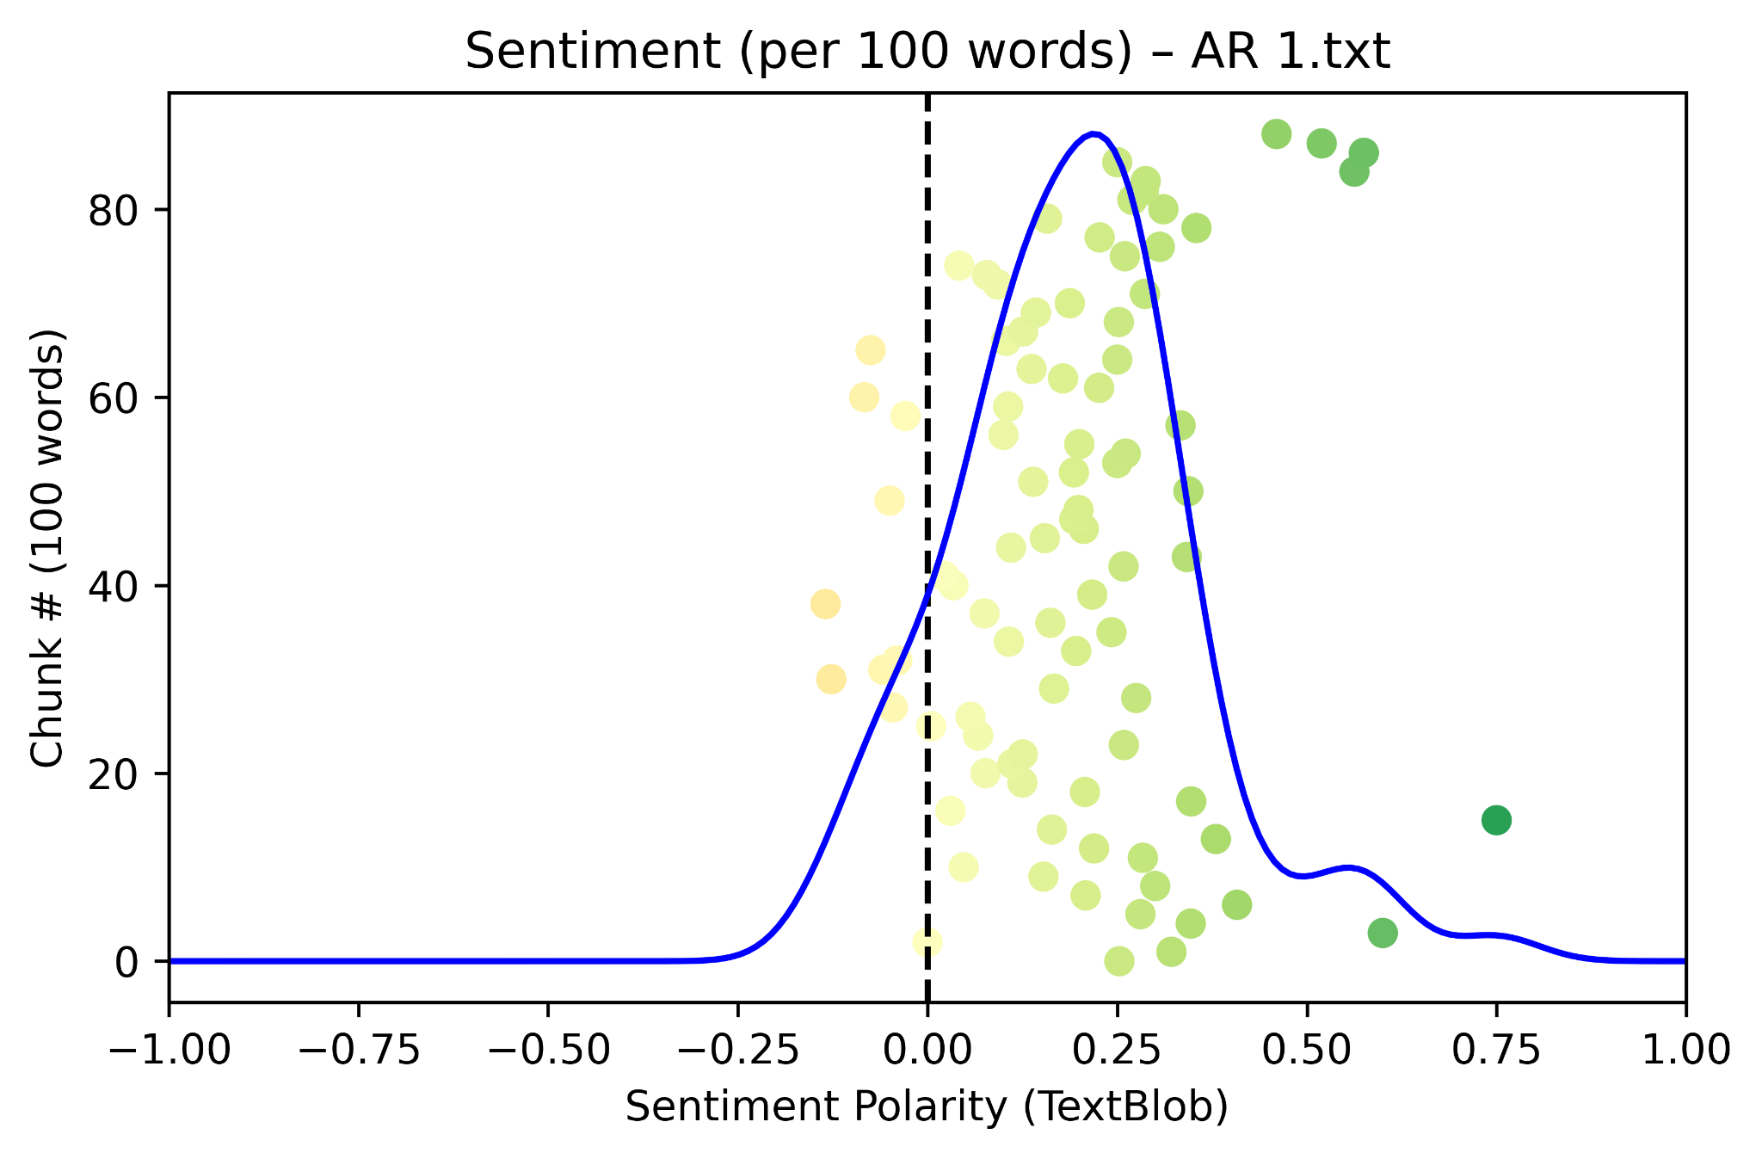
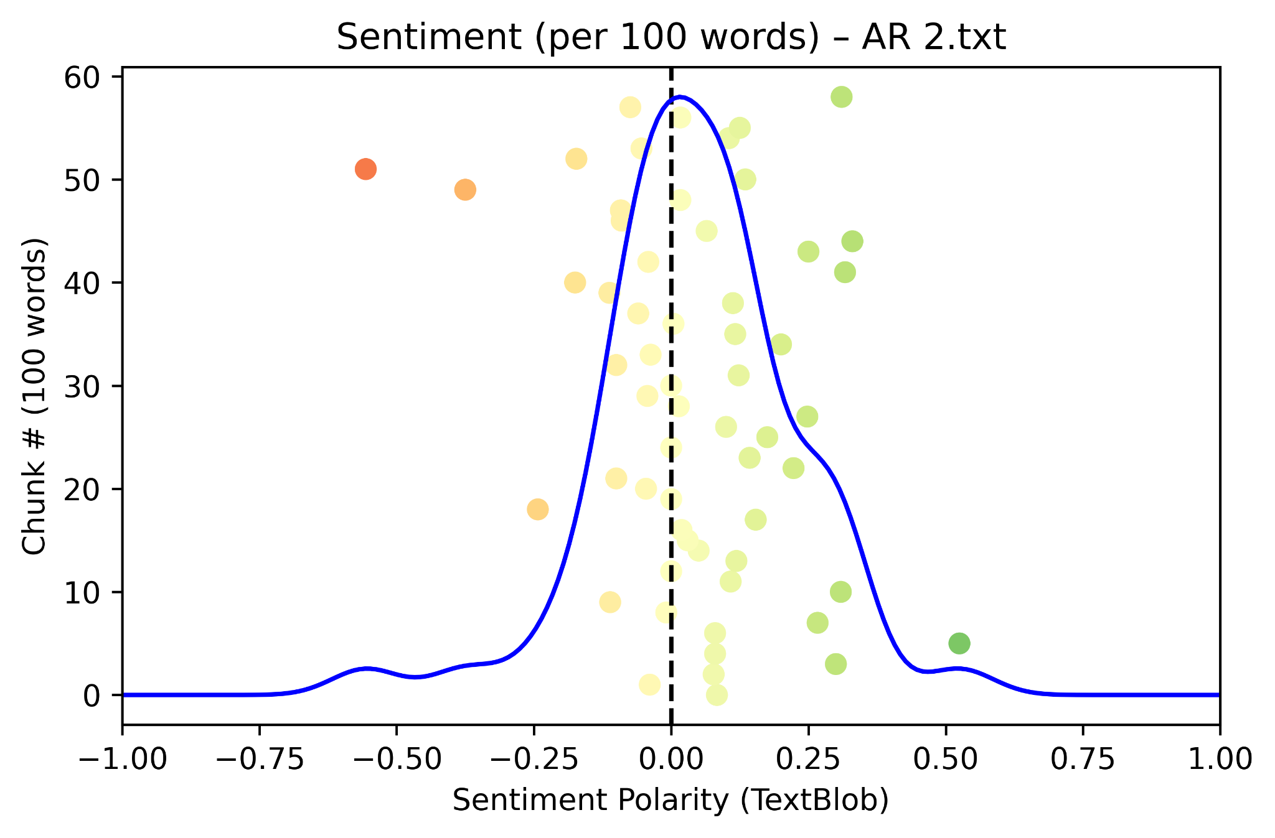
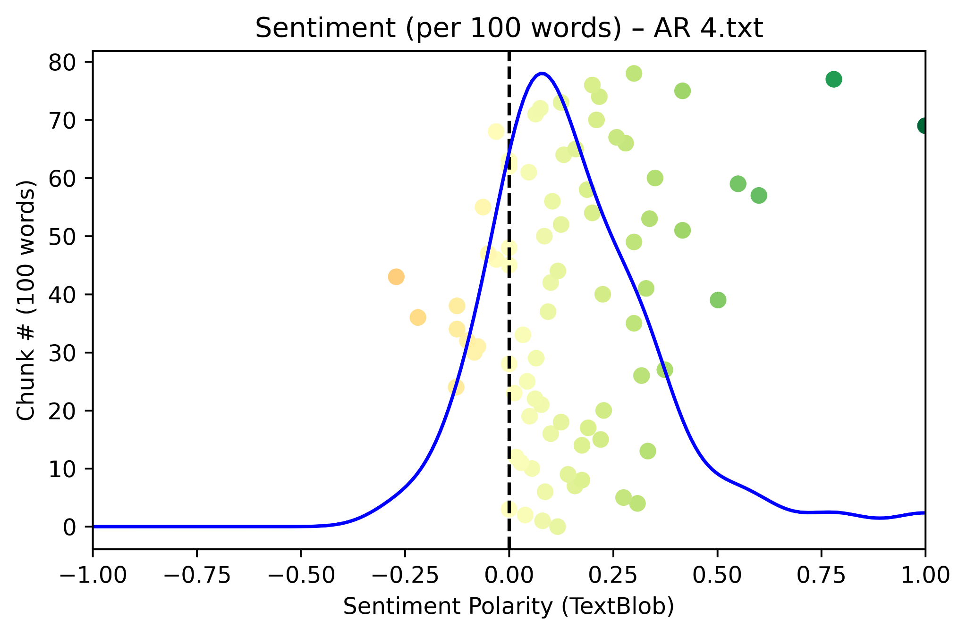
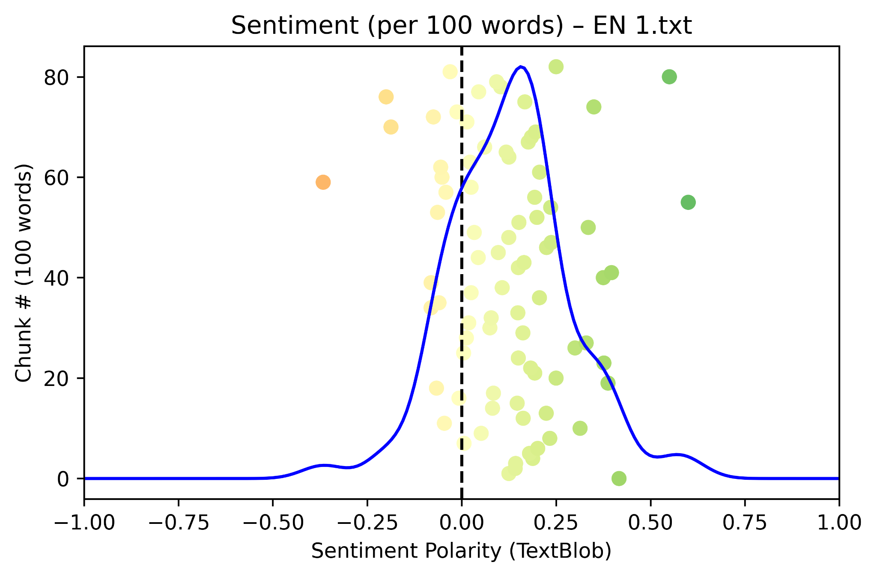
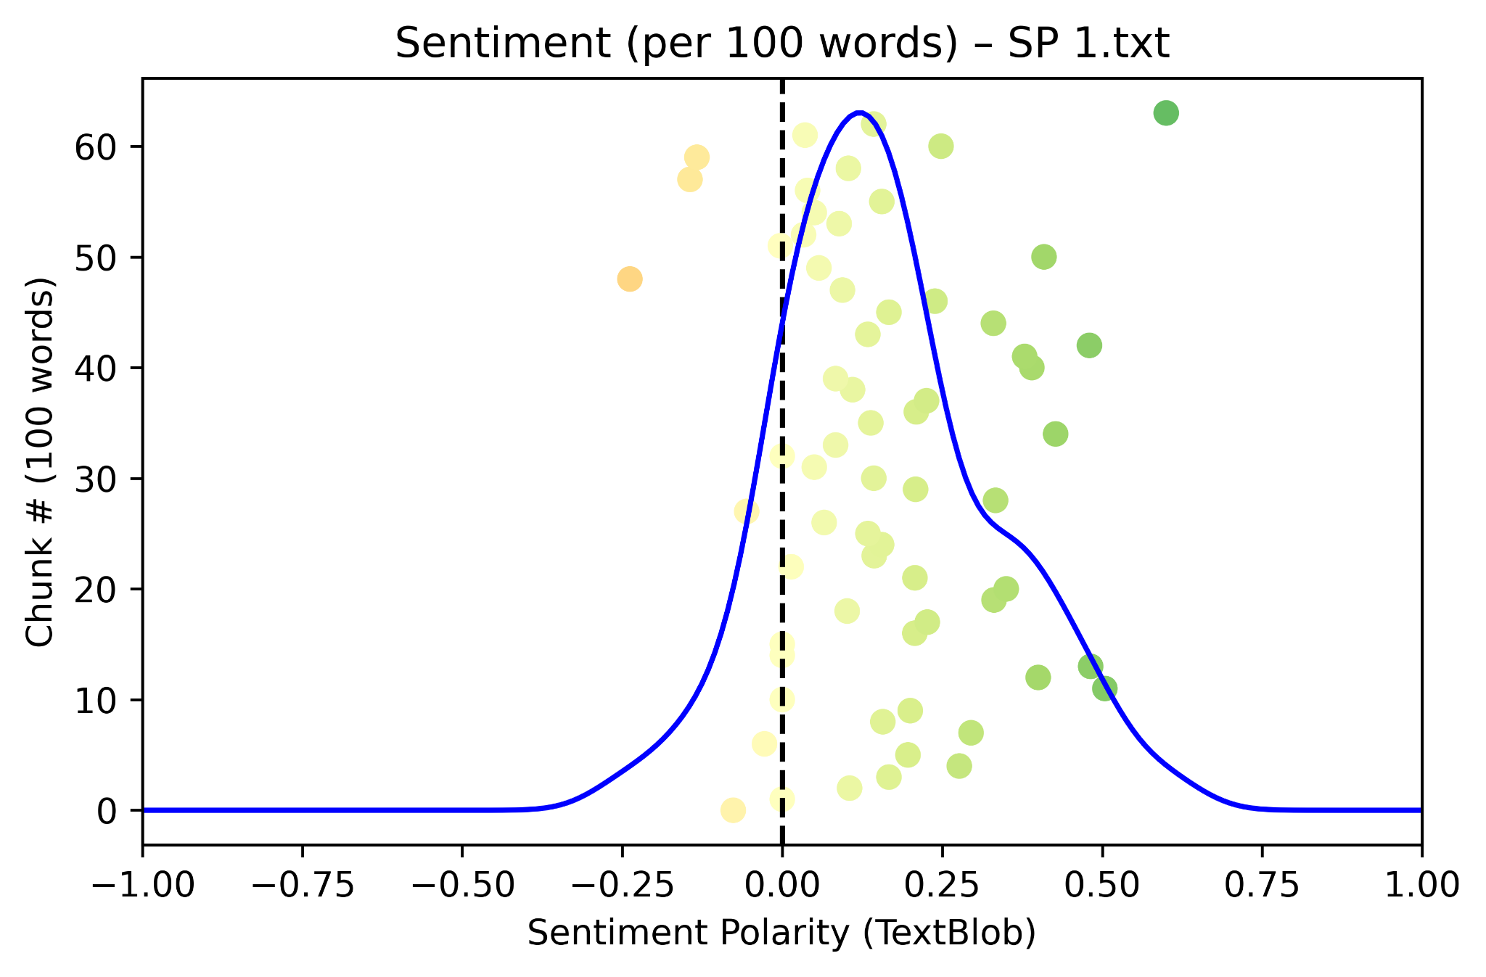
Sentiment Analysis: Teachers
Relational
Linguistic
Organizational
Notes:
Sentiment analysis is the computational process of identifying and classifying emotions or opinions expressed in text (e.g., reviews, tweets, or surveys) to determine if the sentiment expressed is positive, negative, or neutral, helping researchers understand perceptions and feelings at scale. It uses techniques from AI, machine learning, and natural language processing (NLP) to analyze vast amounts of qualitative data and convert it into quantifiable metrics for better decision-making. In this particular case, we used the NTLK (Natural Language Toolkit) and TextBlob packages in Python to process teacher and student interview responses to generate representations of their respective sentiments.
The vertical axis of each graph represents the index of individual word cluster (i.e., going up approximates to progressing through interviews). The horizontal axis represents the sentiment polarity of word clusters with +1 being true positive and -1 being true negative. A blue line curve corresponds to the density of word cluster polarities, offering a visual representation of where sentiments are concentrated.
All teacher interviews showcased sentiment modes which were above true neutral with fair approximations of normal distributions. Overall, this implies a positive teaching experience based upon the interview questions focusing on student experiences/environment. Most also maintain highly positive end-of-interview comments that coincide with final thoughts on MHS supporting newcomer students.

Slide 26
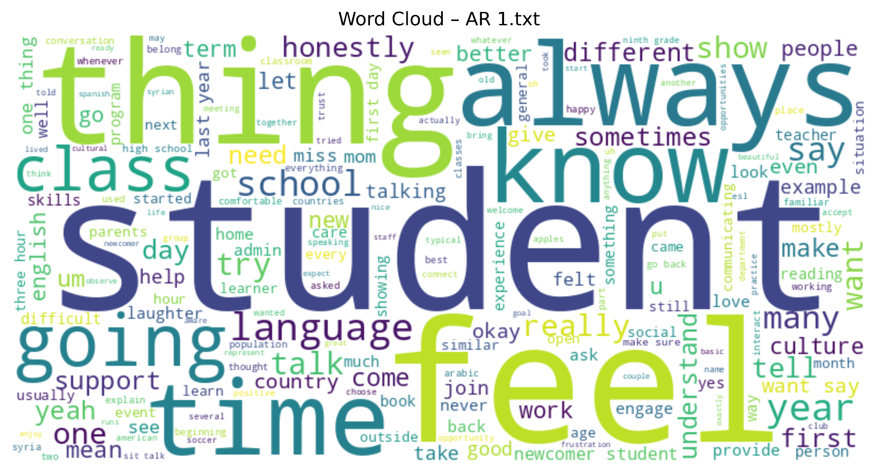
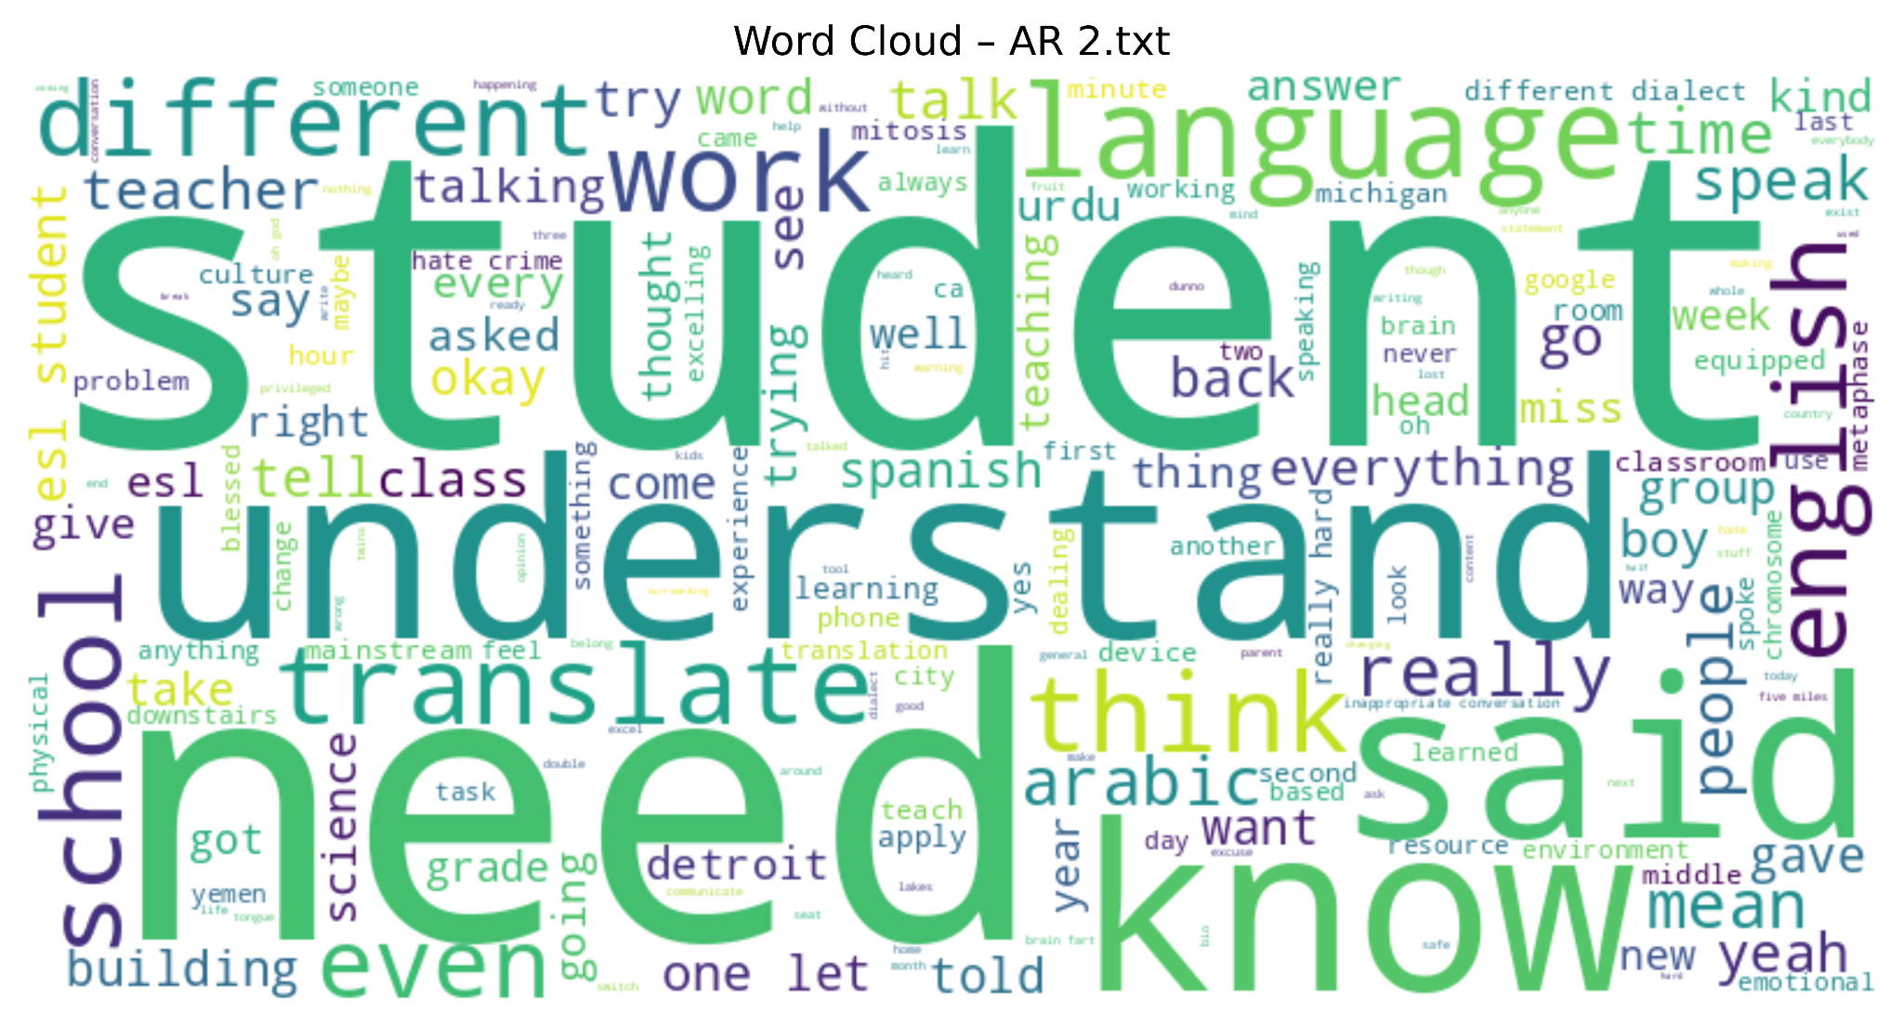
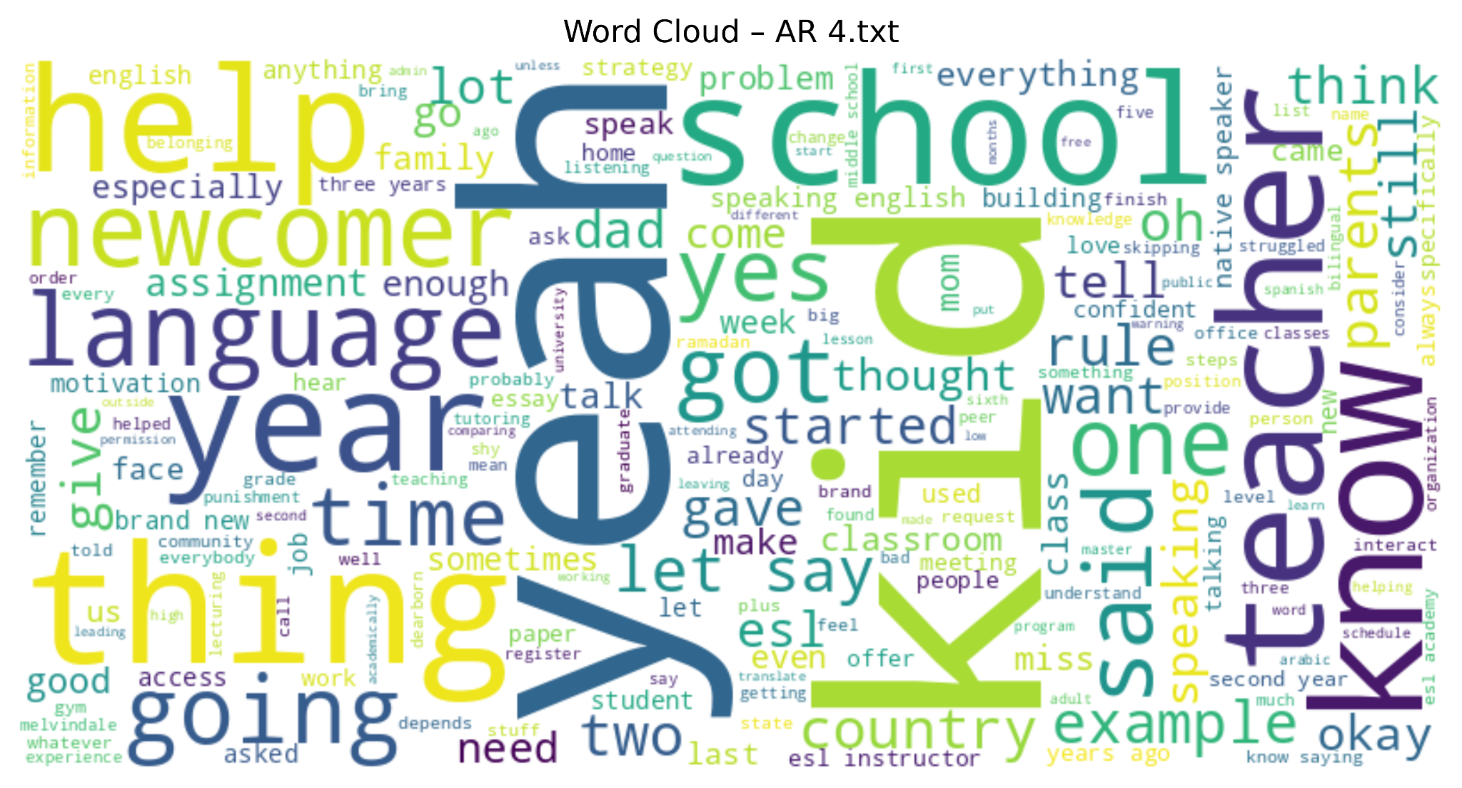
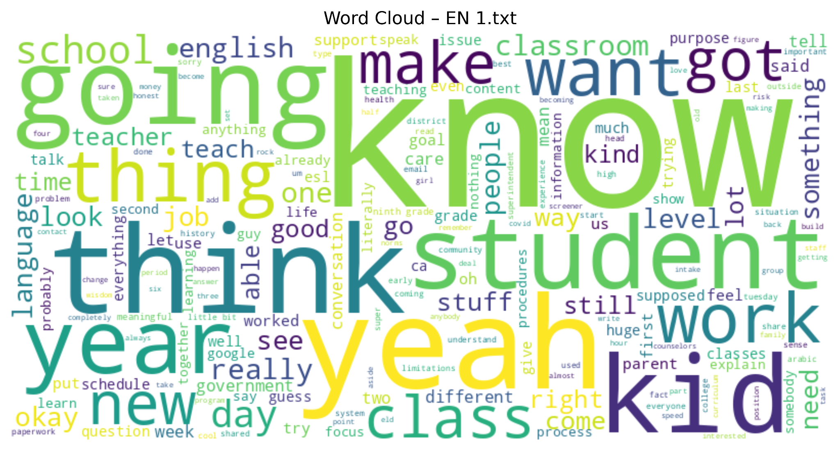
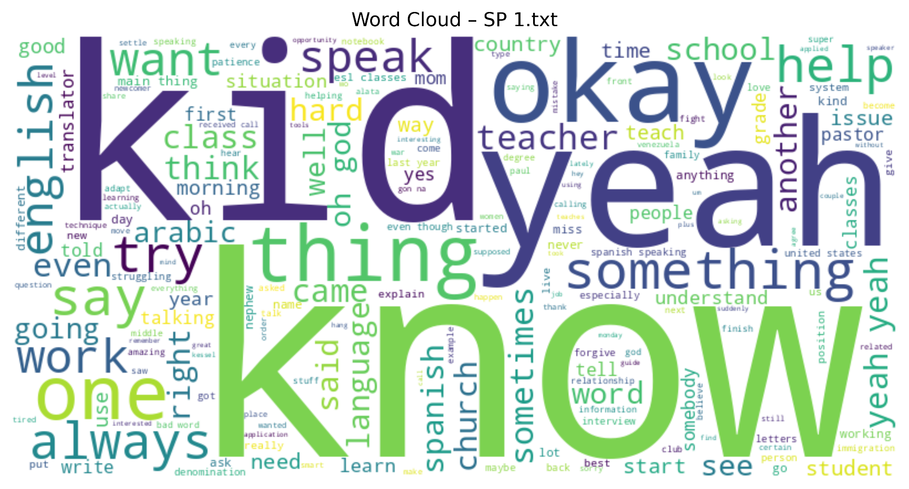
Sentiment Analysis: Teachers
Relational
Linguistic
Organizational
Notes:
Turning the teacher interviews into word clouds, a major point of emphasis is seen on students/kids within responses. Secondary words such as “feel”, “need”, “know”, “feel”, and “help” emphasize a certain degree of action towards that central focus of students. These action-oriented terms demonstrate a level of proactive interactions/interventions on the part of teachers.

Slide 27
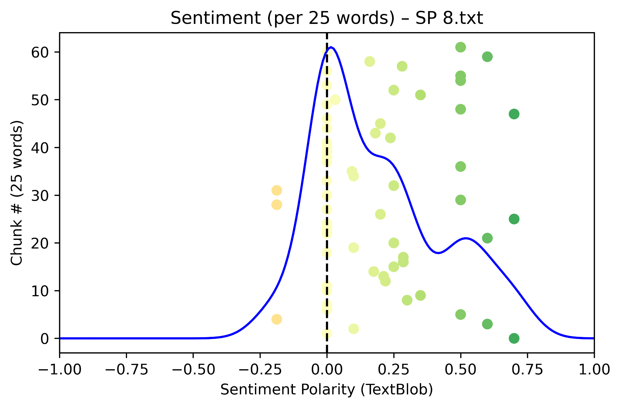
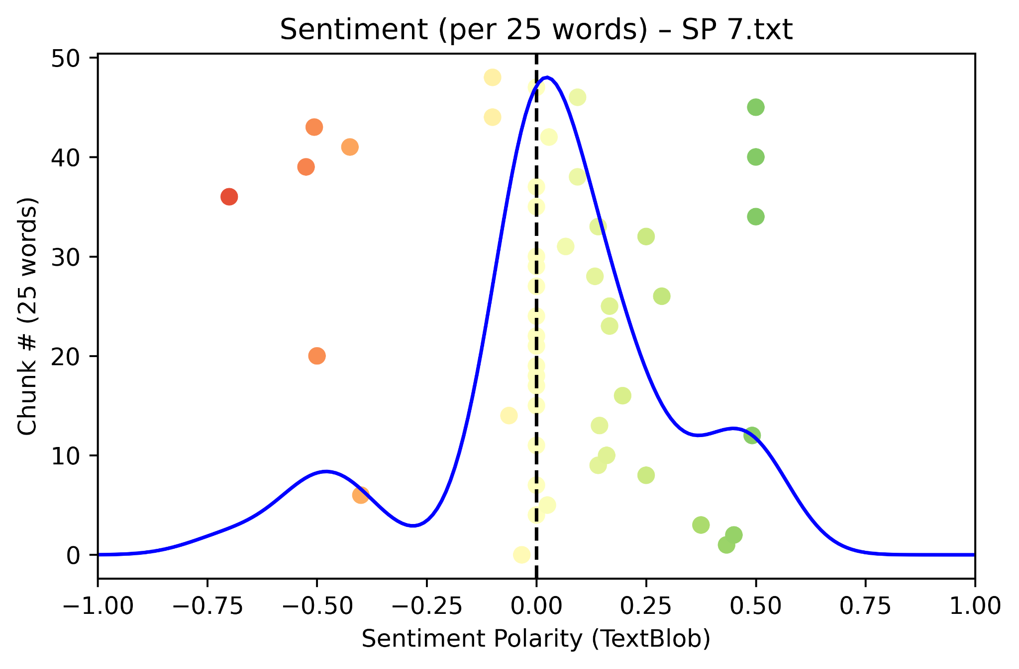
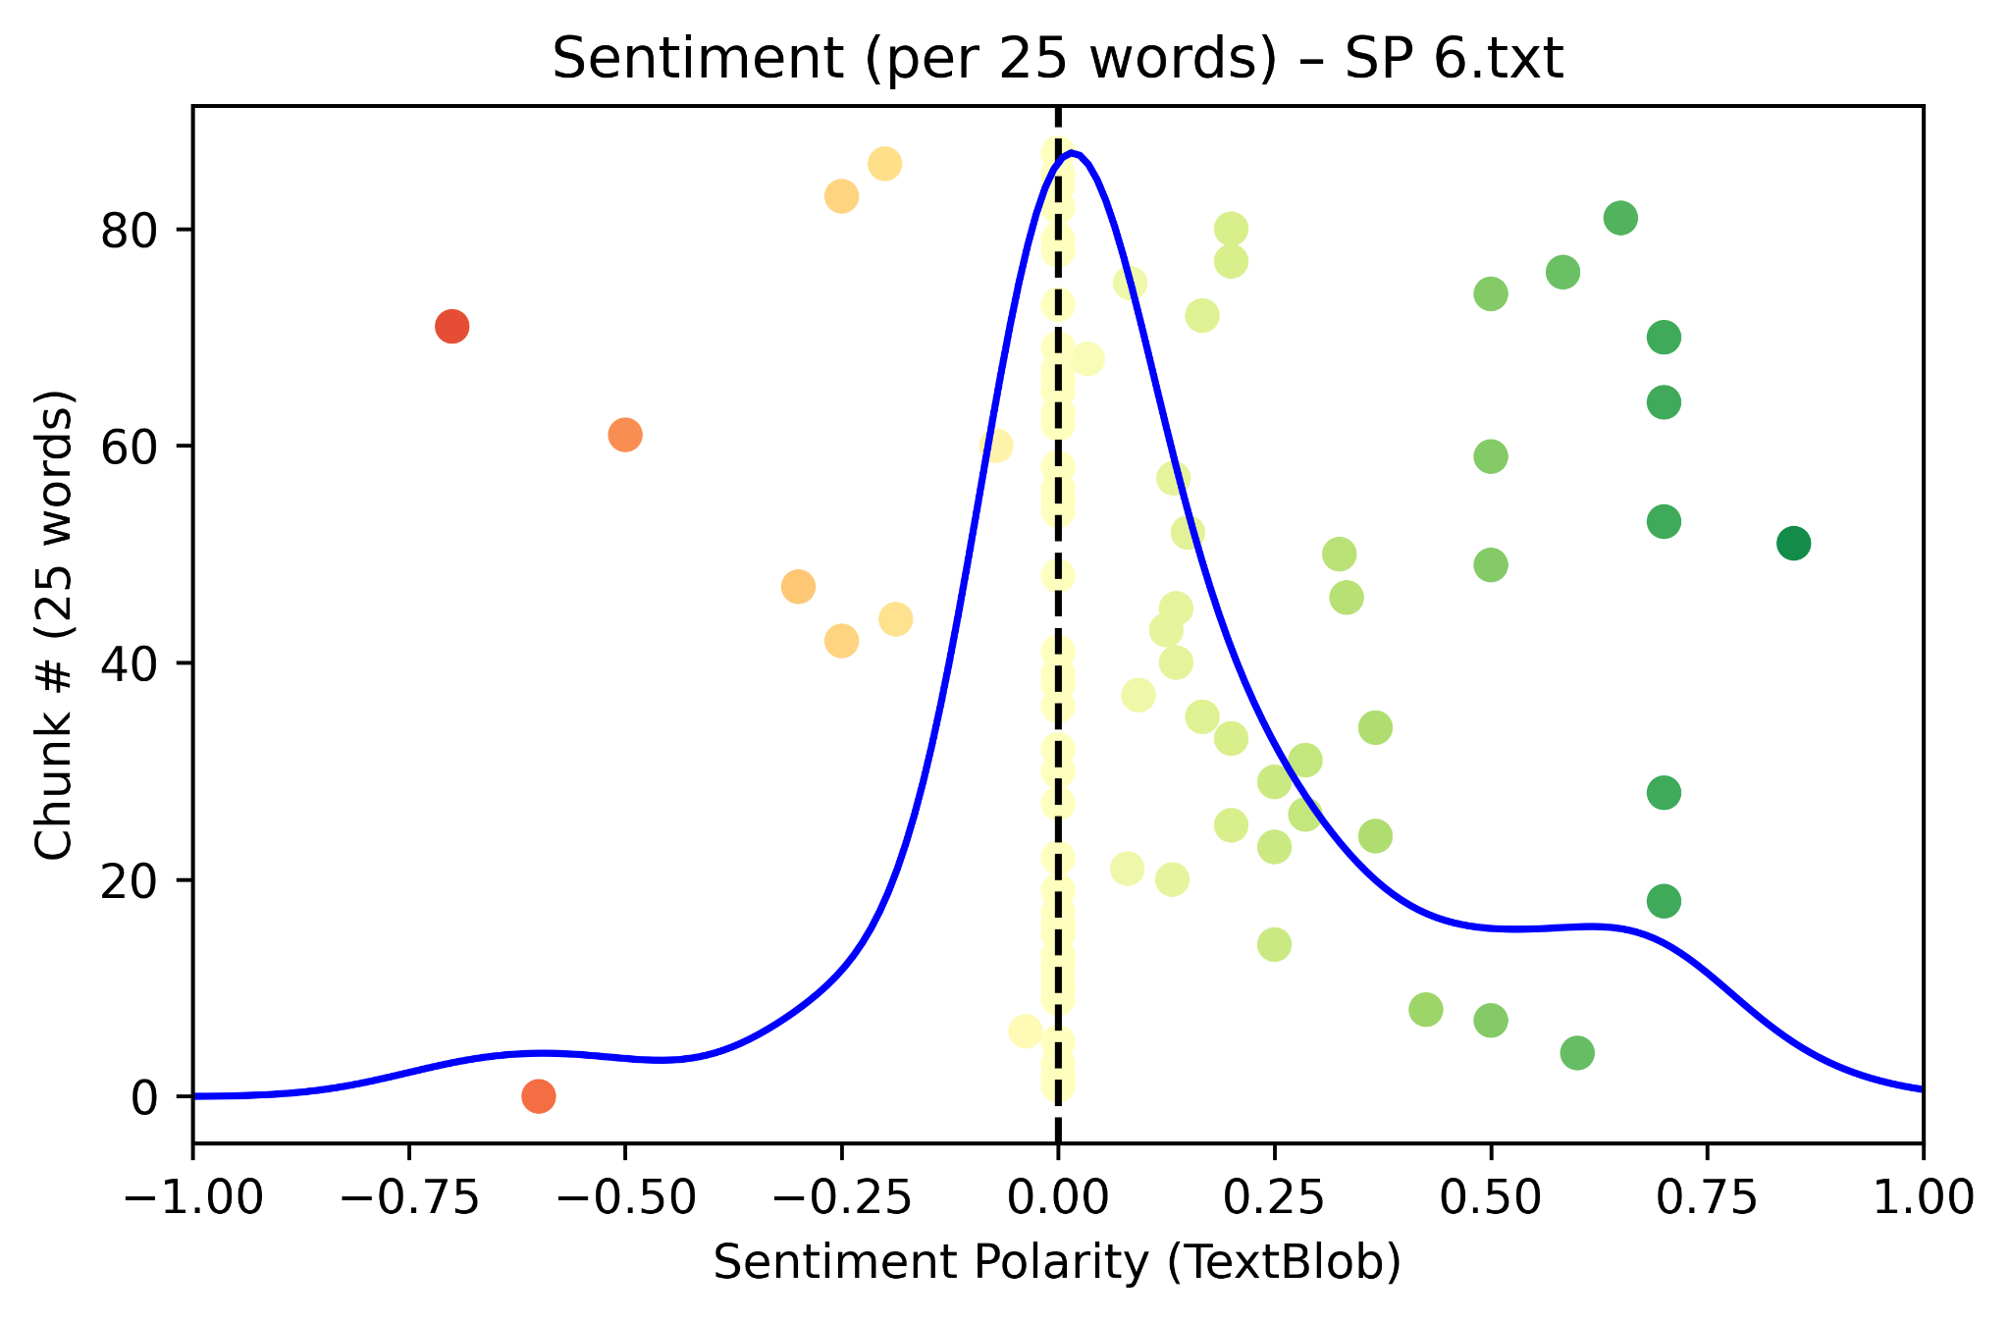
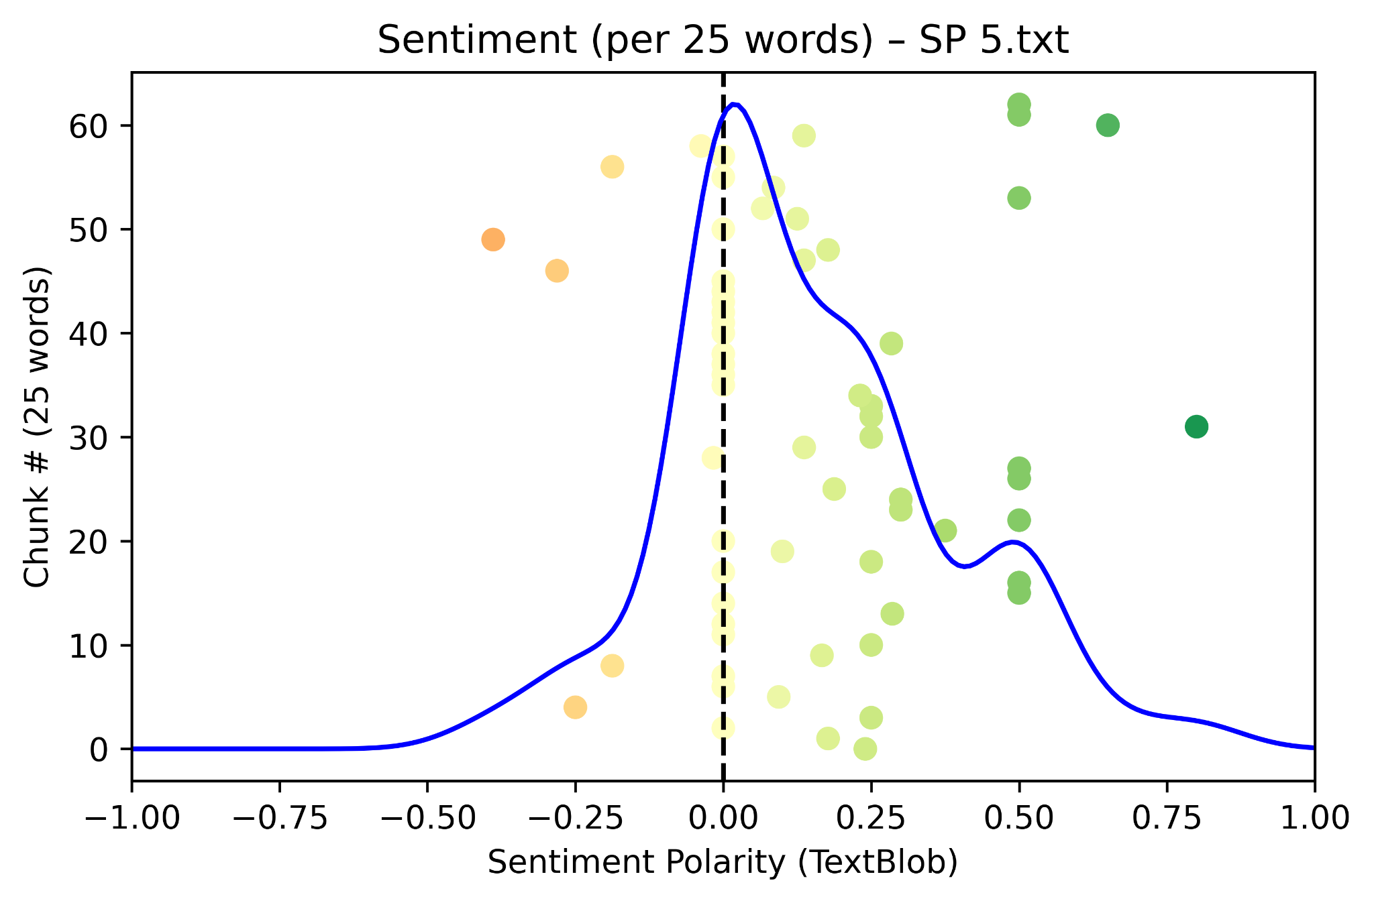
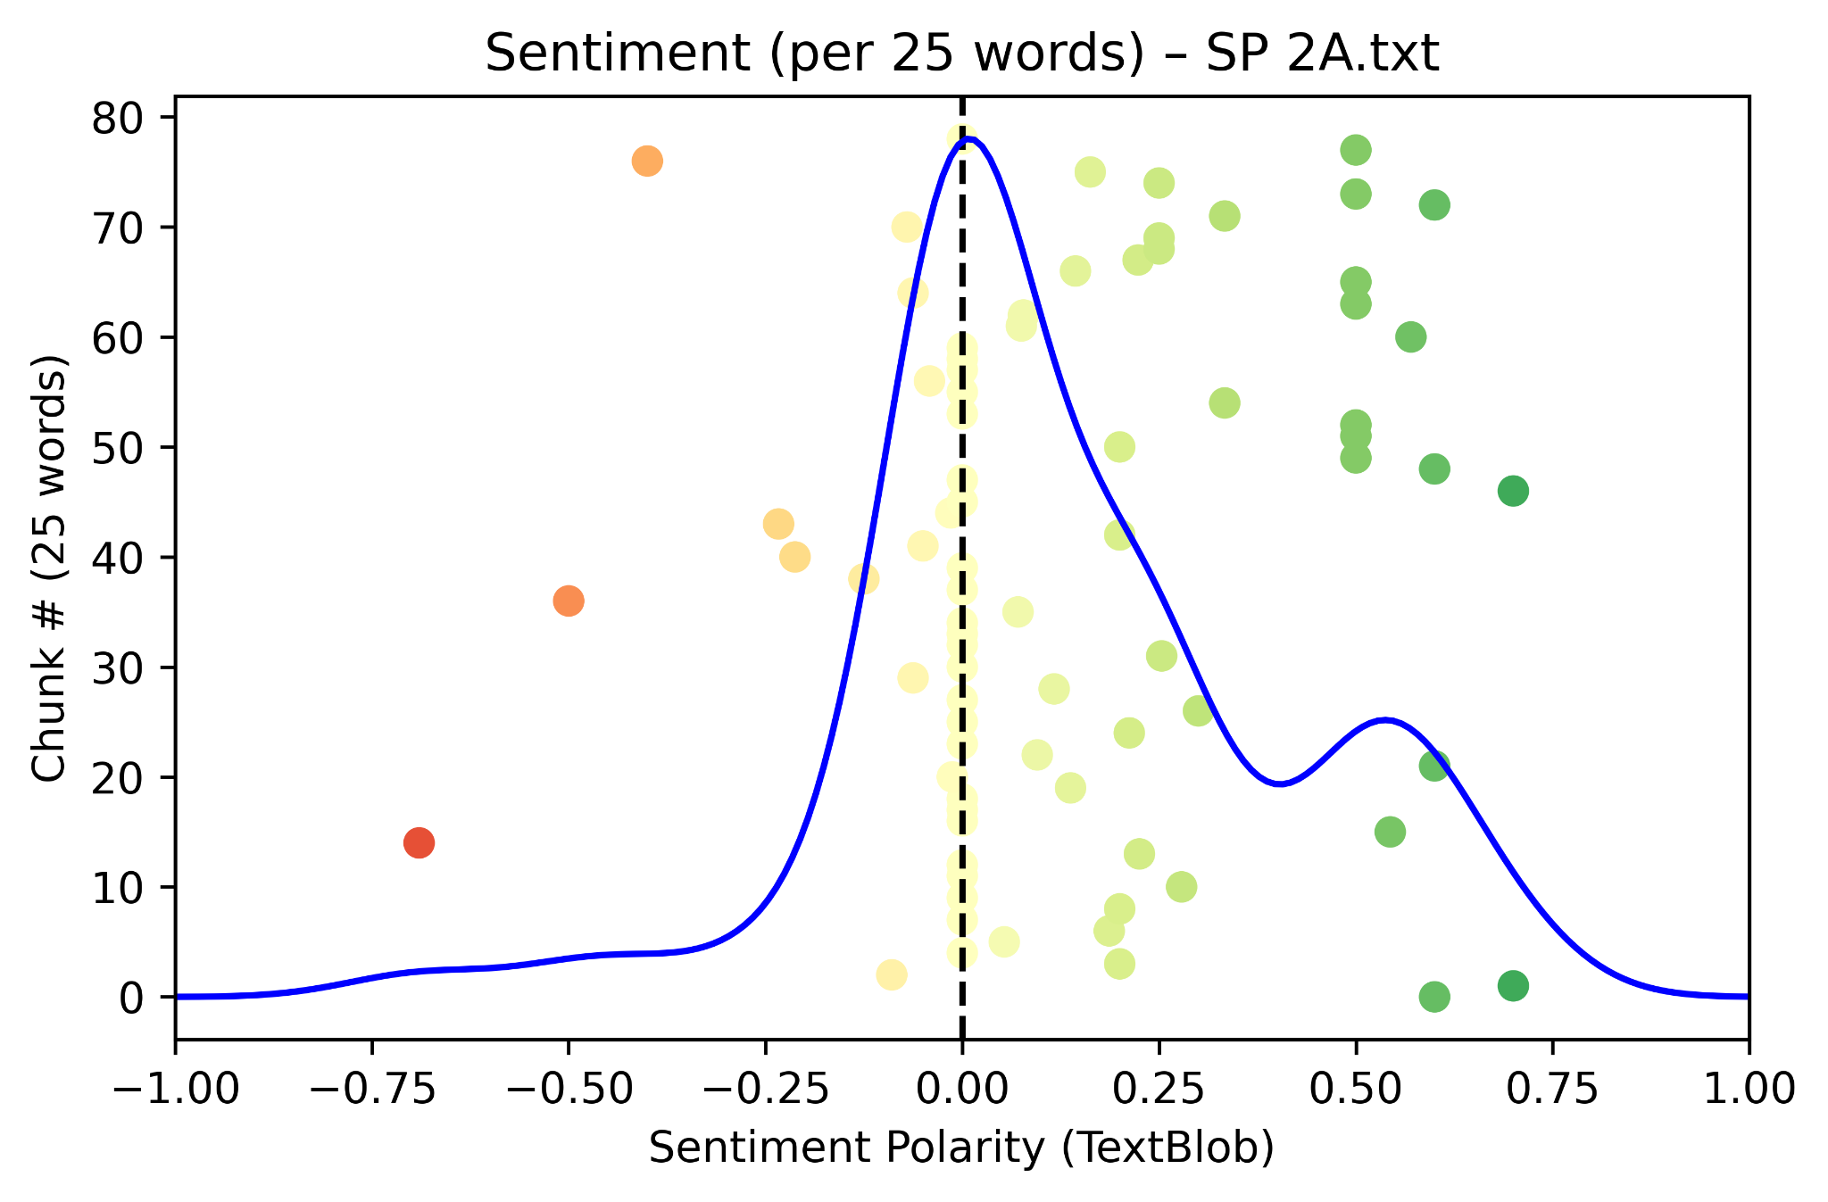
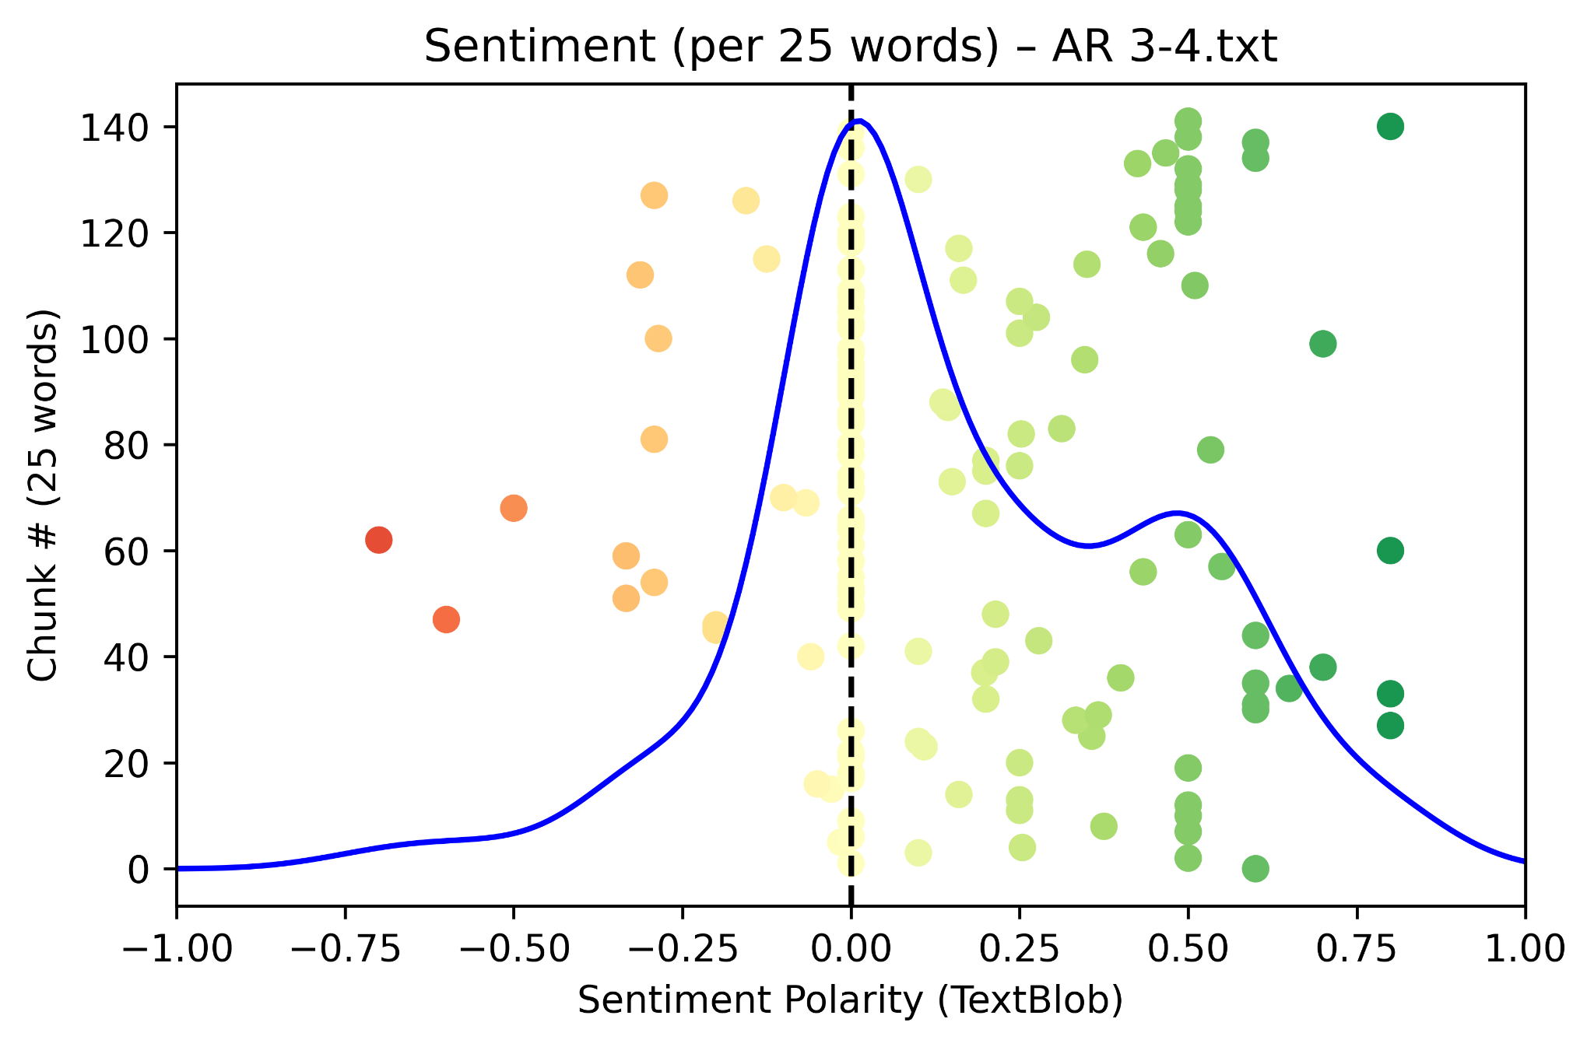
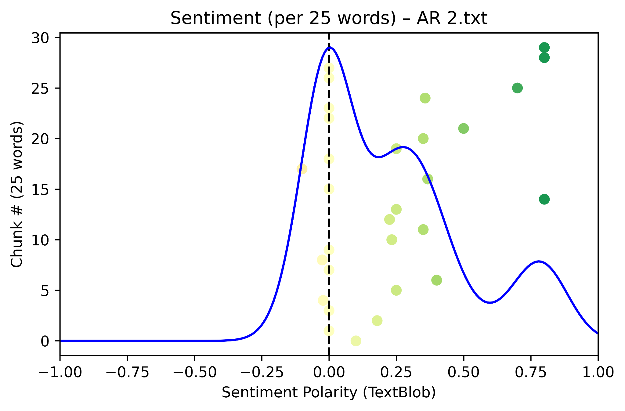
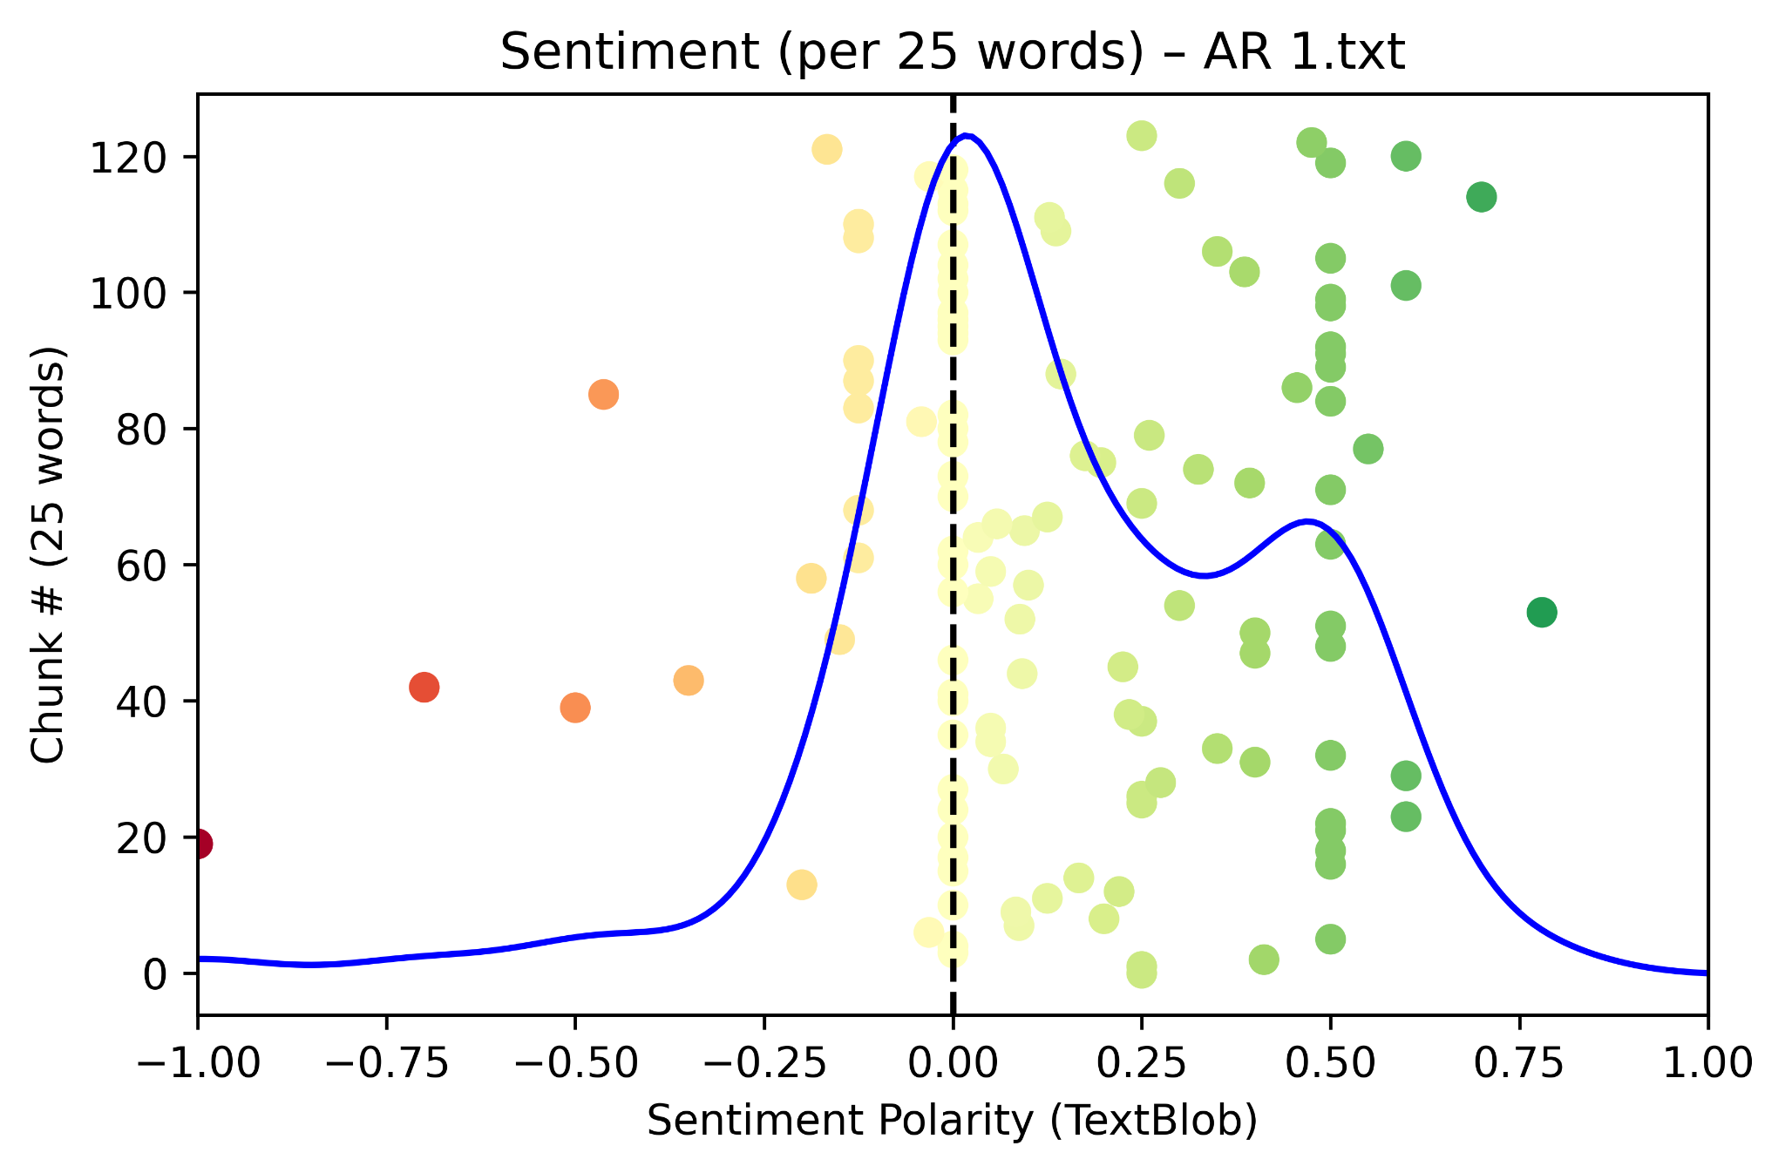
Sentiment Analysis: Students
Relational
Linguistic
Organizational
Notes:
Repeating the sentiment analysis on student interviews, we find much more complex distributions of sentiments.
More technical explanation of what we’re seeing in these visualizations of qualitative data:
Modes are more consistent with true neutrals this time, which can occur based on a number of factors (e.g., length of interview, context obscured, affirmative responses). Total density area leans into the positive regime for all. Some interviews maintain quite distinctive positive local maxs, suggesting that there exists a positive trend with the current set of interview questions.

Slide 28
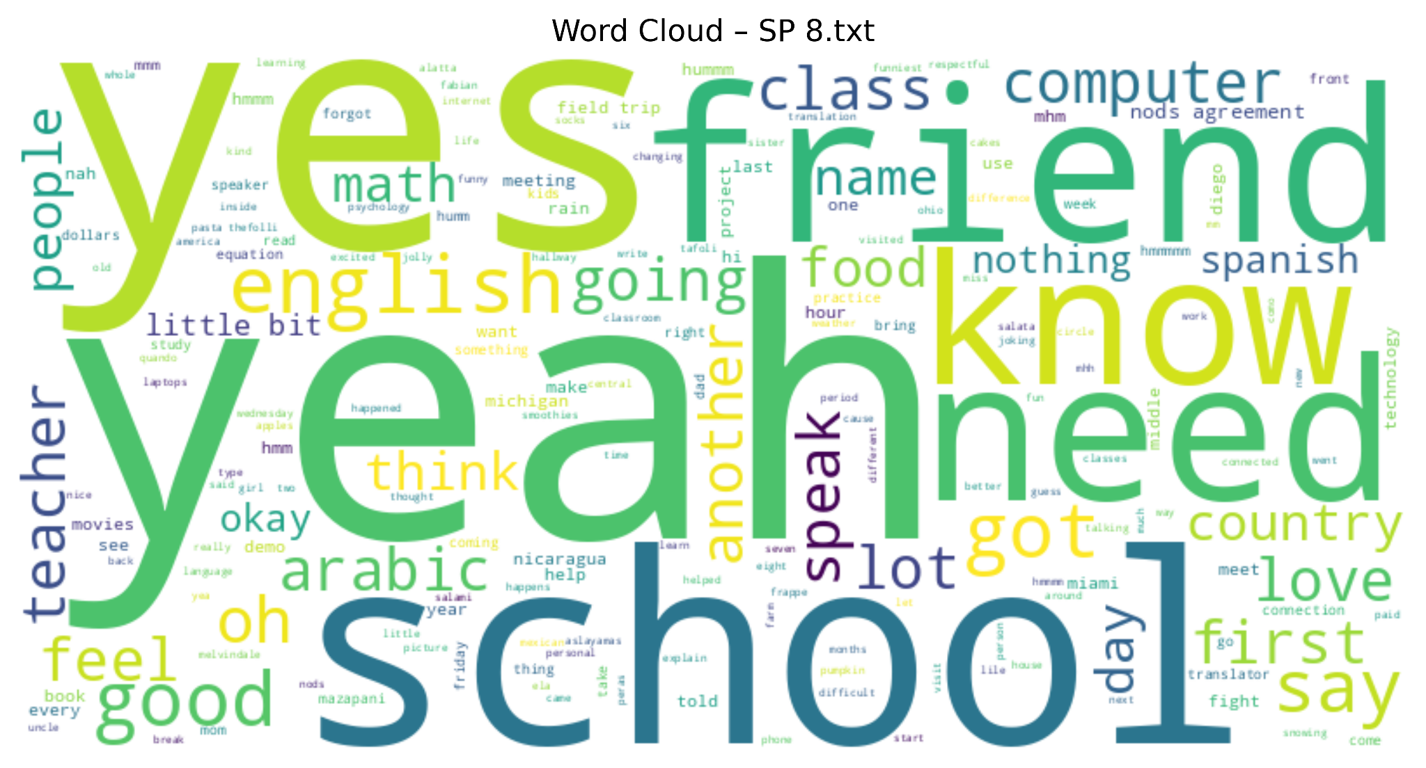
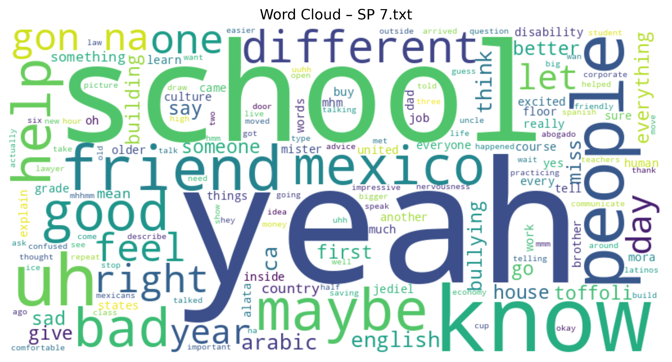
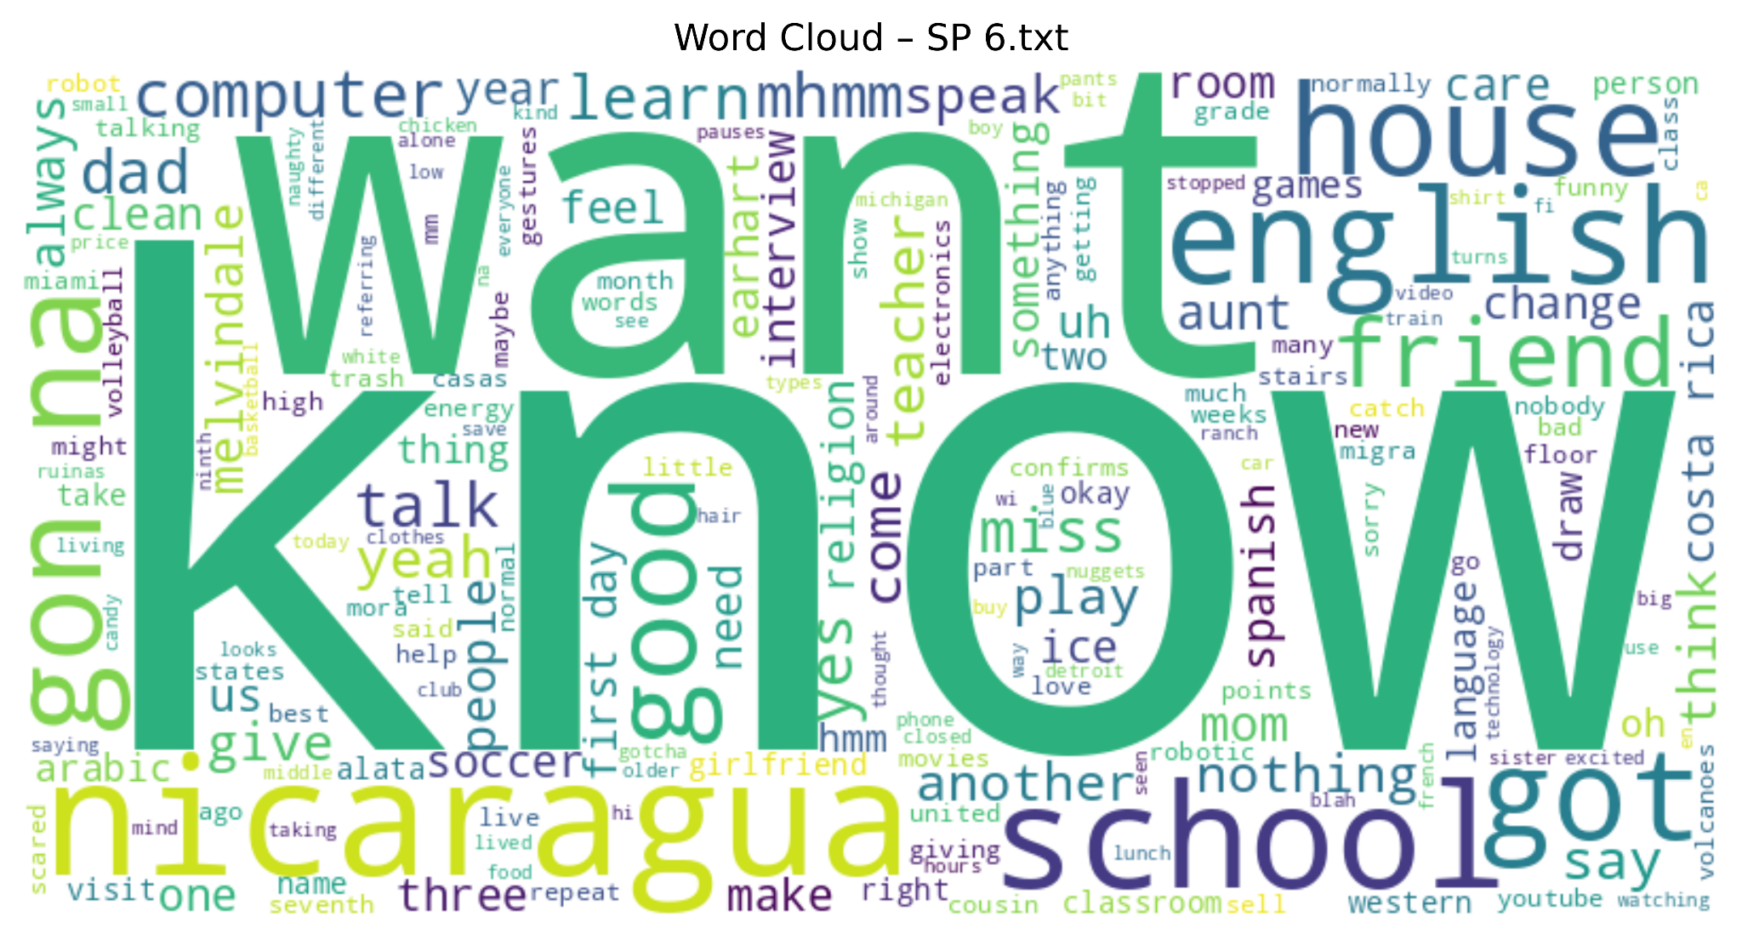
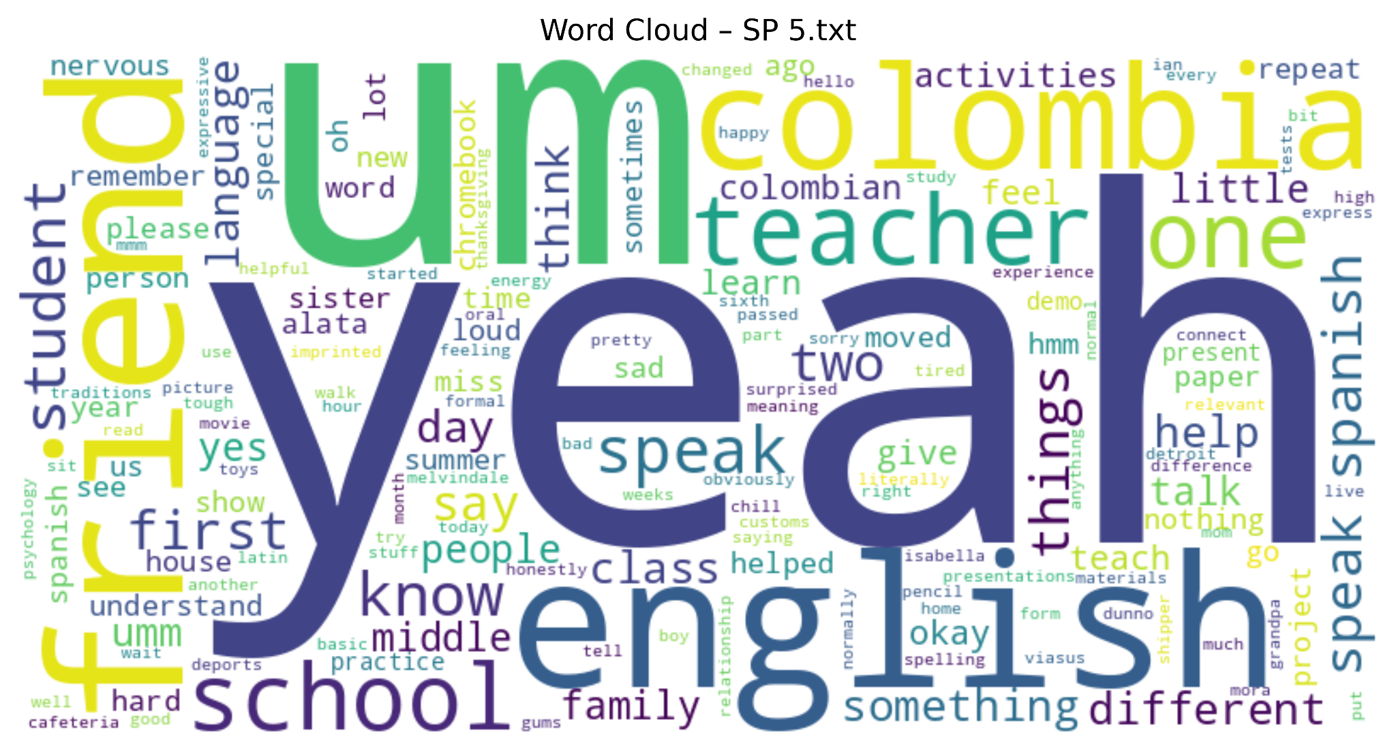
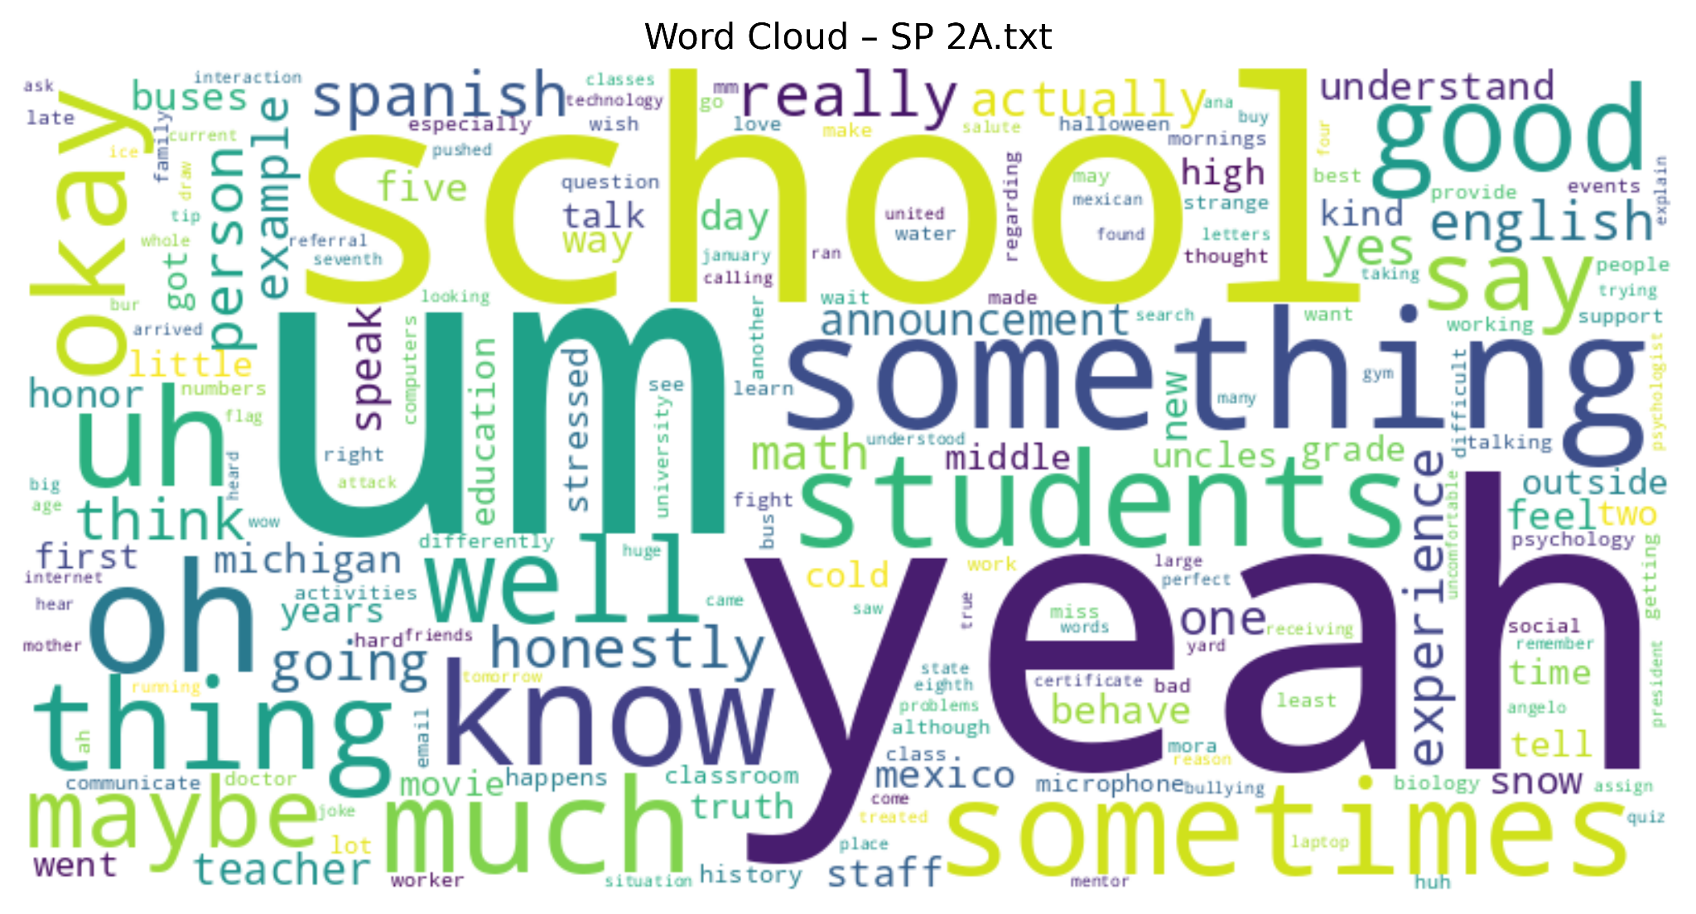
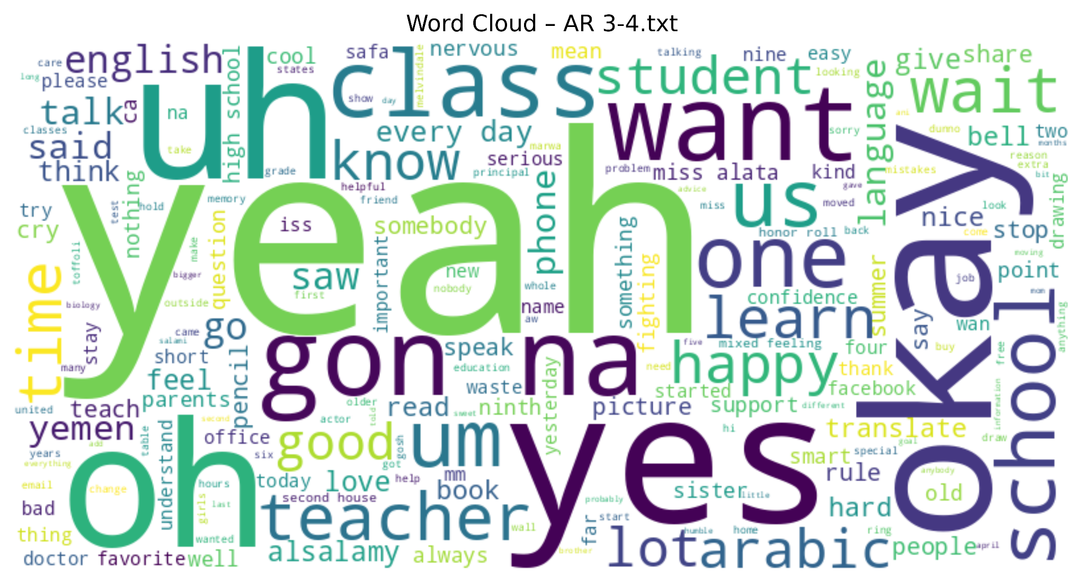
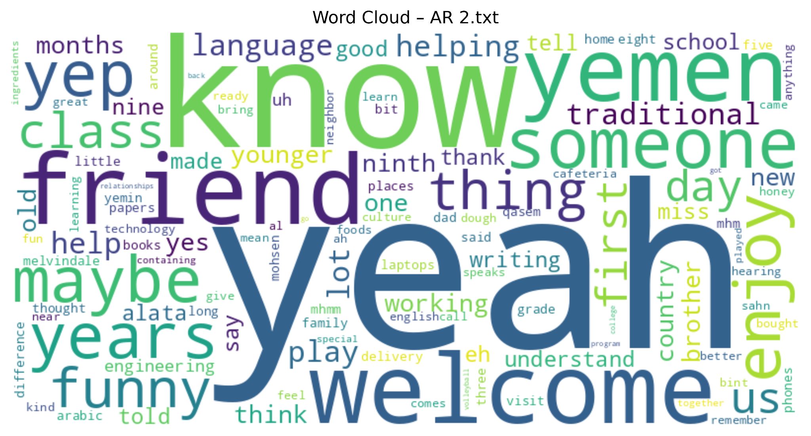
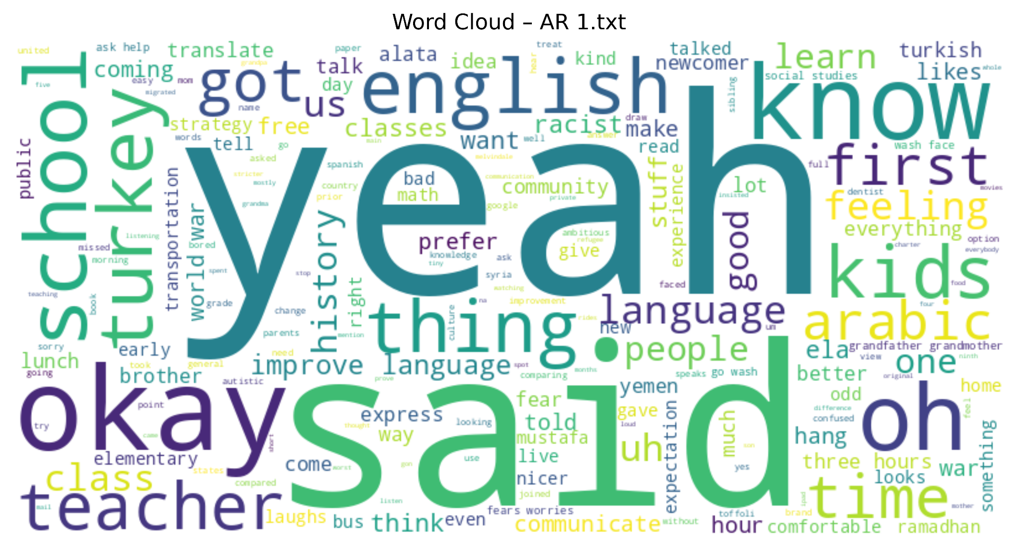
Sentiment Analysis: Students
Relational
Linguistic
Organizational
Notes:
Similarly turning these interviews into word clouds, affirmative responses of “yeah”,‘“yes”, and “okay” are largely evident. These are recorded as neutral in sentiment analysis, rather than as having a positive valence.
Secondary words such as “school”, “friend”, “English”, “know”, and “want/need” show up as an emphasis upon the agreement of mediating factors. That is, the environment and peers support the experiences with language acquisition, general knowledge, and understanding of own desires as focuses.

Slide 29
Finding 3: Challenges
Newcomers Face
Newcomers face challenges related to school norms, discipline, access to orienting information, and the broader sociopolitical context.
Notes:
In response to the challenges portion of our second research question, we found that newcomers face challenges related to school norms and discipline, access to orienting information, and the broader sociopolitical context.

Slide 30
Finding 3: Challenges newcomer students faced
Rules, Norms, & Disciplining
Students shared the ways in which they were socialized and disciplined, both directly and indirectly, through observation and cultural osmosis of the school, including routines, rituals, and norms.
Informational Flow / Navigating Onboarding Process
The challenge lies in the distribution of information and resources, which places students in a position where they must inquire about services they may not even know exist.
Sociopolitical Context
Students navigating external stressors and anxieties around the potential of deportation, global conflict, and family safety.
Notes:
First, we spent time thinking about what the data was telling us about rules, norms, and disciplining.
Students shared the ways in which they were socialized and disciplined, both directly and indirectly, through observation and cultural osmosis of the school, including routines, rituals, and norms.

Slide 31
Finding 3: Rules, Norms, and Disciplining
There may be gaps between what newcomer students are expected to know, and what they actually know (particularly regarding school rules and norms). For example:
Interviewer: “Hi. It's my first day. What is the most important thing for me to know?”
Both students: “Uh, the rules. Rules.”
Interviewer: “Was there any rule that you were like. What? That's a rule. Any [surprising] or shocking rule?”
Student: “Um, give you one rule? The bell like… when the bell, it's ringing you go to your class?”
This student indicated that the use of a bell to enforce class schedules – a common practice in U.S. schools – was surprising.
Notes:
In several of our conversations with teachers and newcomer students, we noticed a pattern emerge concerning divergences between what students might be expected to know and what they actually know.
In the example presented here, a student suggested that the most important thing for a new student to know is about school rules. When asked to provide a specific example of a rule that they found surprising, this student gave the example of a bell signaling the beginning of class. Even when students have prior knowledge of U.S. schooling (e.g., from movies or other media), they may lack awareness of certain elements of day-to-day school norms. This can be present challenges, particularly when the relevant school norms are taken for granted by those more familiar with the U.S. school context (e.g., bell schedules).

Slide 32
Finding 3: Rules, Norms, and Disciplining
Teachers also reported examples of students’ lack of familiarity with certain features of American schooling and culture:
Teacher: ‘‘There’s boys who are very handsy and physical because it's part of [their] culture. And I've just pulled them aside and, like, made them stay after class and talk to them and try to see what happened, not in like, a accusatory or punitive type conversation, and they just don't understand.’’
Teacher: ‘‘For example, when he requests a permission to go to the bathroom, he spends as much he can time … I'm like, okay, I gave you the permission, but you have to finish as soon as you can possible and back to the class in order not to miss the lesson.’’
Teacher: Like even the skipping, like when the teacher is not here and there is a sub, they move and go to other classroom. They don't know … the very newcomer, they thought … okay, the teacher is not here. Like as if they consider it as a free time..’’
Notes:
Newcomer students’ lack of familiarity with certain aspects of U.S. school norms may manifest in behaviors that violate common school rules.
In the first example listed here, a teacher describes how he has handled male newcomer students engaging in physical contact with one another. The teacher describes this type of contact as a part of their culture, and tells us that when he explained to the students how their behavior is interpreted in the U.S. school context, he is met with confusion.
In the second example, a teacher describes a situation where a student asked for and received permission to use the restroom, and stayed in the restroom for more time than was appropriate. This example suggests a lack of familiarity with how bathroom passes are commonly used in U.S. schools.
Similarly, in the third example, a teacher describes how students skip class when their teachers are absent. In the context of the full interview from which this quote was generated, the teacher made it clear that this was a gap in cultural awareness of the students. Students indicate that in some of their home countries, it uncommon to have class when your teacher is absent, as there is no substitute teacher practice.

Slide 33
Finding 3 - Rules, Norms, and Disciplining
Students shared the ways in which they were socialized and disciplined, both directly and indirectly, through observation and cultural osmosis of the school, including routines, rituals, and norms.
In addition to the signals around the school through media or announcements, school actors provided examples of disciplining behaviors like:
“he doesn’t bring his pencil [to class], so the teacher said [snapping fingers] go to ISS.”,
“I can see cell phones, they need to go away”
“stop talking to one another”
Students learn expectations/rules by being disciplined for not knowing what is “normal” or “expected of them”. They also learn by watching this happen to other students in the school. These events socialize students to the environment.
Notes:
Broadly, we found that discipline operated as a mechanism for students becoming socialized to the school. This doesn’t necessarily need to be the MO. Disciplinary norms can still be upheld while also addressing the disconnect between our school norms and where student knowledge exists. Below are quote examples.
In addition to the signals around the school through media or announcements, school actors provided examples of disciplining behaviors like:
“He doesn’t bring his pencil [to class], so the teacher said [snapping fingers] go to ISS.”
“I can see cell phones, they need to go away.”
“Stop talking to one another.”
Importantly, students are learning how they are expected to be - disciplined for what they know and what they don’t. They learn this through their own discipline and by watching discipline occur. This is another factor in their socialization to MHS and the U.S. education system.

Slide 34
Finding 3: Challenges newcomer students faced
Rules, Norms, & Disciplining
Students shared the ways in which they were socialized and disciplined, both directly and indirectly, through observation and cultural osmosis of the school, including routines, rituals, and norms.
Informational Flow / Navigating Onboarding Process
The challenge lies in the distribution of information and resources, which places students in a position where they must inquire about services they may not even know exist.
Sociopolitical Context
Students navigating external stressors and anxieties around the potential of deportation, global conflict, and family safety.
Notes:
Informational Flow and Navigating the Onboarding Process is another challenge we identified. The challenge lies in the distribution of information and resources, which places students in a position where they must inquire about services they may not even know exist.

Slide 35
Finding 3: Information Flow - Language Anxiety
Students' language anxiety regarding communicating in English can affect their connections with peers, hinder them from sharing and asking questions, and lead to a fear of missing out on important information.
An 11th grade peer mentor explained that his assigned mentee spoke Spanish, while he did not, leaving him unsure how to communicate or participate meaningfully.
During the interview, [9th grade ESL student] was getting frustrated with the translator, his hand shaking as he went to press the button to speak. I could tell there was some frustration of not being able to clearly communicate what he wanted to tell me in English.
So you're saying that when there's something important announced, having it in both languages would be helpful so that you don't miss it? (student nods with excitement) Okay.
Notes:
Students’ anxiety around communicating in English may prevent them from asking questions, giving administrators the assumption that everything is operating smoothly.
Perhaps reassuring students that any important information that require follow-up actions will be communicated to them directly or that they should feel empowered to ask teachers for clarification if they are unsure if announcements affect them.

Slide 36
Finding 3: Information Flow - Navigating Onboarding Process
One challenge may not be the need for new resources, but rather a standardized process of sharing information with students during their onboarding process.
Students request services such as “the school [providing] a buddy for students to meet and talk with,” without realizing that the Peer Mentorship Program is available to them
Interviewer: “They're doing a peer mentorship to pair new students here at
Melvindale with students who have been here for a while…So you’re not
part of it?”
Student: “No…How I can be part of that?... I want to know about that”
Notes:
One challenge may not be the need for new resources, but rather a standardized process of sharing information with students during their onboarding process.
For example, several students actually asked for or identified the structure of the peer mentorship program, without knowing that this program was being piloted.

Slide 37
Finding 3: Information Flow – Navigating Onboarding Process
Teachers expressed the importance of providing support to newcomers as they learn to navigate a new school, but also that it can be frustrating when students arrive at different points in the year:
ESL Teacher: “So my part is basically introducing them to the class, talking about the most important things that they need to have, just so they feel like I don't know where I'm at … What's a chromebook? Why do I need headphones? Why do I need to have this? What's a notebook?”
ESL Teacher: “I want to be done with procedures after two weeks. I don't want to talk about where you get your classwork, because now I got a new kid, and they're like, Where… am I? And, you know, the other kids can explain to them, if they're comfortable with it, but they're also lost and in like this shock that everything's brand new.”
Notes:
All of the teachers that we talked to expressed their empathy and understanding of the challenges that newcomer students faced. However, some also expressed that it is challenging to support newcomer students during their initial entry into the school. This was particularly salient for teachers when discussing newcomer students who arrived during the middle of the school year. Newcomer students’ lack of exposure to certain elements of U.S. schools (for example, digital technology and procedural elements within classrooms) creates a barrier for newcomers as they are adapting to their new environment, and can impose additional burdens on ESL teachers - who must focus both on instructing their students and in re-orienting new students. At times, these duties may instead fall to support teachers or other students, as indicated in the second quote on this slide.

Slide 38
Finding 3: Information Flow – Access to Graduation Resources
ESL Teacher: “We face a lot of absentees, so … when [the student’s dad] came here, he wants … [his kids] to be here, but they don't want [to be at school].”
…
“Then after talking … we discover like one of the kids … she doesn't have enough credit and she thought she's not going to be graduate until she was 21 or 22. Then when we gave her this motivation [that] as soon as you build up your credit, we'll give you the classes for juniors so you can graduate with the people in your age.”
Here, a teacher indicates that the school began to motivate a student toward graduation after a behavioral incident (absenteeism). Students may benefit from a proactive approach to outlining graduation pathways.
Notes:
In one conversation with a teacher who works with newcomer students, they described a situation where they had to meet with a family to discuss absenteeism. During this discussion, the teacher discovered that one of the students who had been absent lacked the motivation to attend school, because she did not see a path to graduate with her peers. The teacher explained that the school was able to motivate the student by clearly explaining her pathway towards graduation.
This example highlights a situation where a newcomer student lacked relevant information about her academic path towards graduation, which resulted in a behavioral issue. This situation also highlights the systems that the school has in place to address the challenges that newcomers face. It invites the question of whether there might be opportunities to construct proactive systems that address gaps in information when newcomer students arrive?

Slide 39
Finding 3: Challenges newcomer students faced
Rules, Norms, & Disciplining
Students shared the ways in which they were socialized and disciplined, both directly and indirectly, through observation and cultural osmosis of the school, including routines, rituals, and norms.
Informational Flow / Navigating Onboarding Process
The challenge lies in the distribution of information and resources, which places students in a position where they must inquire about services they may not even know exist.
Sociopolitical Context
Students navigating external stressors and anxieties around the potential of deportation, global conflict, and family safety.
Notes:
While not very pervasive throughout the data, we thought it was important to include this information as a lens through which we might understand students experiences, especially for an ever-changing sociopolitical environment.

Slide 40
Finding: What challenges do newcomer students face?
Sociopolitical context - student stressor (or challenge?)
Community members shared that the sociopolitical climate was a major stressor for them. Many students talked about the impacts on their family and home community with the war in Gaza, or the fear in their community of deportation, and what support from MHS looks like. Throughout a students’ interviews, they shared that it feels difficult to manage life, school, friends, etc. when you’re worried about ICE. Multiple interviewees shared frustration with the MHS community on the topic or how they were navigating tensions:
Chronosystem
Macrosystem
Exosystem
Mesosystem
Microsystem
Teacher: "It's like, what is going to happen to me next year? … some of the things that's happening right now in the country that you're supposed to be free, you're supposed to be living. It's almost the same things that happen when you live in your country and things that happen, that you have to move out of your country."
Student: “Honestly? I feel too much. A little stressed. Uncomfortable about what's going on and how students in schools are taking it as a joke or something.”
Notes:
The current sociopolitical and historical context is an added stressor for students. This fits into the ‘macrosystem,’ paying credence to the ways our larger societal contexts impact the experiences of actors in your school.
Community members shared that the sociopolitical climate was a major stressor for them. Many students talked about the impacts on their family and home community with the war in Gaza, or the fear in their community of deportation, and what support from MHS looks like. Throughout a students’ interviews, they shared that it feels difficult to manage life, school, friends, etc. when you’re worried about ICE. Multiple interviewees shared frustration with the MHS community on the topic or how they were navigating tensions (exemplified in quotes).

Slide 41
Recommendations
3
Notes:
We are now shifting into recommendations, which follow from our key findings.

Slide 42
STRENGTHENING THE ONBOARDING PROCESS: INFORMATION FOR TEACHERS
Teachers are requesting more information about students before they enter, including:
Country of origin
Primary language
Language spoken at home
Schooling history (how many years, which country, disruptions, etc.)
English language ability
He told me that he wishes that there was a consultation on the student with the teacher with a counselor so they could talk about things like where they’re from, what their levels are, but the students just show up and may not even have a WIDA score to gauge their level.
— Notes from Interview with Teacher
Notes:
The first is to create a robust orientation and onboarding process:
Currently, teachers are given little information about students before they enter the classroom. Teachers need more information before the students actually step foot into the classroom including:
Country of origin
Primary language
Language spoken at home
Schooling history (how many years, which country, disruptions, etc.)
English language ability
Some of this information is likely recorded in your Home Language Survey, but we recommend sending it to teachers and expanding on the questions.

Slide 43
STRENGTHENING THE ORIENTATION PROCESS: PROGRAMMING FOR STUDENTS
Students need to learn US cultural norms including:
What the bell means
How to use the computers (Google Classroom, etc)
How to go to the bathroom (where they are, bathroom passes, etc)
Creation of a Peer Orientation program:
Peer Mentoring program leader acts as a “buddy” for newcomer students
Student remains mentor over extended period of time to help with transition
Informational videos on what to expect
at MHS
“[School] can be easier if someone older than you helps you about in the school, to know the school around, and telling you what, which Is your class like, and give you advice about what's going on in the school” — MHS Student
Notes:
This recommendation also pertains to students.
Upon arrival, students need to not only learn about MHS, but also US education norms including:
What the bell means
How to use the computers (Google Classroom, etc)
How to go to the bathroom (where they are, bathroom passes, etc)
MHS common rule violations (e.g., bathroom pass etiquette, absenteeism, etc.)
Key touchpoint in school for issues (counselor? ESL coordinator? Teacher? Newcomer Liaison?)
Pathway to graduation + expectations from the school
School calendar
Hand-raising
Co-educational classrooms
School technology
One idea is to create informational videos for both families and students on what to expect from their student going to MHS in multiple languages. These could also have information on who students and families could approach if they need guidance.
Additionally, students can have another student (potentially a leader from the Peer Mentoring program) give them a tour of MHS and tell them about these school norms. This would be another good way to introduce them to the Peer Mentoring program and get them involved in that as well. This program could also help students build connections with other students with similar backgrounds and a shared language. Especially considering how important the connection between peers is (as discussed in Finding 1), this could help reduce anxiety and ease students into the new school. Though the peer mentorship program being piloted is premised on this connection and includes a physical orientation to the building, this intervention likely arrived later than newcomer students needed it, telling us that the Peer Mentoring program needs to be up and running before school begins.

Slide 44
INCREASE NUMBER
OF ELL CLASSES AND STAFF
Students rely on ELL teachers, staff, and classes
ELL Courses have had a great impact on language acquisition and a sense of belonging
Large class sizes can deter students from seeking help
Staffing with students’ home languages in mind provides greater accessibility for students, especially for Spanish speaking students
“We need more staff who speak at least a little Spanish so they can understand something, especially if the new students don't know where their classroom is or something like that.” — MHS Student
“Another thing is more like more classes, more ESL classes for them, like another ESL classes. We have 20 something kids in one single class and it's hard for [the ESL Teacher] to teach like an individual to them.” — MHS Staff Member
Notes:
Students often cite how ELL instructors and support staff help develop their language acquisition and nurture sense of belonging.
Recommendations from students and staff focus on increasing the number of ELL courses on offer.
Courses designated for ELL students help develop language acquisition and senses of belonging
Given the amount of conversations on learning routines and school structure, having more ELL staff members that are equipped with the tools to work with students (extra benefits if they speak the same language) would provide students with greater opportunities in the school environment
Specifically, students who speak Spanish commented on feeling like they do not have as much access to support for events, the classroom, and general procedures

Slide 45
CLEAR & CONSISTENT
EXPECTATIONS
Disciplinary - Multiple students spoke about learning the rules:
What is expected to bring to class daily? What is the penalty for infractions? These must be consistent.
Consider translating PBIS matrix to Spanish and Arabic.
Cultural - If students did not grow up in US schools, they may not understand the unwritten rules of American schooling:
Newcomers may need direct instruction on bells, horseplay, substitute teachers, buses, lunch lines, etc.
Organizational - Procedures must be clear and consistent as well:
Requesting a course, getting additional help, joining a club or sports team, checking whether they are on track to graduate. By ensuring all of this is laid out for newcomers, all students can potentially benefit.
Relational
Linguistic
Organizational
Notes:
There is also a need for clear & consistent expectations.
Students and staff both expressed concern around inconsistent application of standards. Multiple newcomers exemplified the need to learn the rules when you start at Melvindale. What needs to be brought to class daily? What happens if they don’t bring those things?
The PBIS matrix is published all over the school, could it be translated to help support those for whom there is a language barrier?
Students who were socialized in non-US educational contexts, and may not know norms around bells, horseplay, substitute teachers, lunch or bussing. The procedural and structural pieces cause a lot of additional burden on teaching staff trying to ensure newcomers are ready to thrive, on top of the difficult task of being an educator in the first place.
Consider: Who do you want teaching students expectations? Without a plan you’re leaving it to chance, and we know there are a lot of students who should not be in charge of teaching these expectations!
Not everything is disciplinary or punitive. Expectations on how to get involved with extracurricular activities, take desired courses, ensure they are on-track for graduation, and get help when they need it is crucial for fostering belonging.

Slide 46
MULTILINGUAL
RESOURCE GUIDE
Language accessibility is needed for students to succeed in the classroom
There are gaps of expectations
Verbal announcements at school should be in English, Arabic, and Spanish
As noted in the student artifact, a developed multilingual guide given to students in their primary language can help alleviate common stressors, as noted by mentor students
“There was an announcement the other day about the buses running out of water or something. So they were going to be late. I didn't understand why they were going to be late, and I had to ask for a lot of help. I got really stressed. So it's not just a lot, I got really stressed. Mm. So I would say that maybe there's someone who speaks Spanish in the announcements, and after they say it in English or in Spanish, something really, really bad happens, you know?” – MHS Student (Translated from Spanish)
Notes:
We recommend that MHS develop a multilingual resource guide that includes where to go for help, school navigation, multilingual teachers, community resources, the written and unwritten expectations at MHS/US Schools, requesting classes, getting involved.
Gap between what students are expected to know and what they actually know
Bell example
Cultural differences and what is normalized
Distribution of Information is fragmented
Communication/Absenteeism
Language Anxiety/Flow
Mentees, but diff language, don’t know how to participate meaningfully…
We envision this as a potential collaborative, iterative artifact that the peer mentorship program can both develop and use in future programming, guided by student input and provided by school leaders to help smooth the process for newcomer students.

Slide 47
RECOMMENDATIONS
FROM INTERVIEWS
Students and teachers were able to voice their recommendations on practices that could support MHS newcomer students. These include:
Cultural fairs and dances; more opportunities to be in community with one another
More English learning programs or activities
Targeted outreach to invite more newcomer parents in the school
“He wants more language support and teachers who understand where each student comes from.”
— Teacher Interview
Notes:
One teacher also pointed to wanting more cultural activities or dances. This would engage more students and could even increase parent involvement. When discussing current events, one teacher pointed out: “They don't come to Prom or Homecoming because they are wearing a scarf and they're not allowed from their culture to go to a party”. Recognizing and responding to student interest could make the difference in student engagement. In addition, there were interviews where students and staff routinely commented on less community engagement than desired: parents and guardians are not always involved, there are at times tension outside of school which students carry into school with them, impacting their relationships.
Similar to the request for more ELL classes, many students and teachers recognize the need for more English language learning opportunities. One teacher discussed offering an additional hour of English learning after the school day. Several students indicated they were interested in learning more English through conversations and partnerships with their peers.

Slide 48
Thank You!
Notes:
Thank you for the opportunity to learn from and with you this year!

